Slide 1






Un aperçu non-exhaustif des possibilités de l’IA
D. Laiymani et C. Guyeux

Slide 2
Objectif de ce cours
Savoir quoi faire avec l’IA.
Avoir une liste d ’applications en tête
Connaitre certains algorithmes
Pour l’instant, rien de technique, juste une une introduction générale

Slide 3
L’IA sur des données tabulaires (nombres, matrices)

Slide 4
Clustering (regroupement)
Regroupés des individus au sein de groupes homogènes

Slide 5
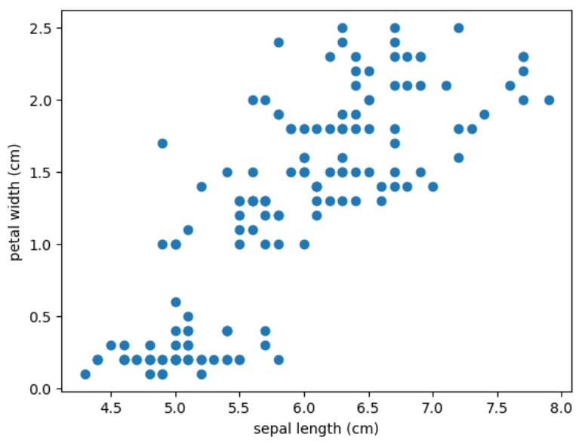
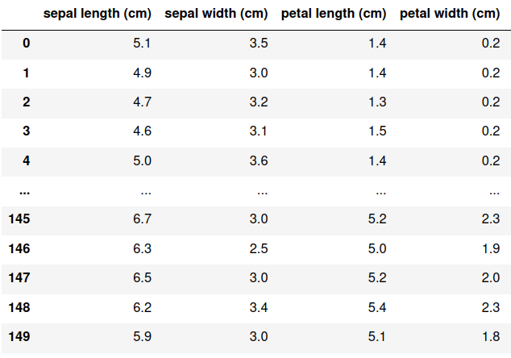
Clustering

Slide 6
Clustering

Slide 7
Clustering: challenges
Combien de groupes ?

Slide 8
Clustering: challenges
Combien de groupes ?

Slide 9
Clustering: challenges
- Combien de groupes ?
- Que faire des cas atypiques ?

Slide 10
Clustering: challenges
- Combien de groupes ?
Que faire des cas atypiques ?
Comment évaluer un clustering ?
Comment choisir entre 2 clusterings ?

Slide 11
Clustering: challenges
- Combien de groupes ?
Que faire des cas atypiques ?
Comment évaluer un clustering ?
Comment choisir entre 2 clusterings ?
Quelle méthode utilisée ? Avec quels paramètres ? ((k-means, mean shift, DBscan, hierarchical clustering…)

Slide 12
Classification
Prédire une classe à partir de caractéristiques

Slide 13
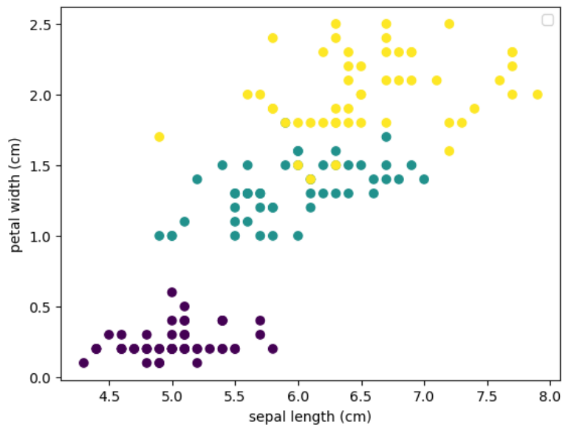
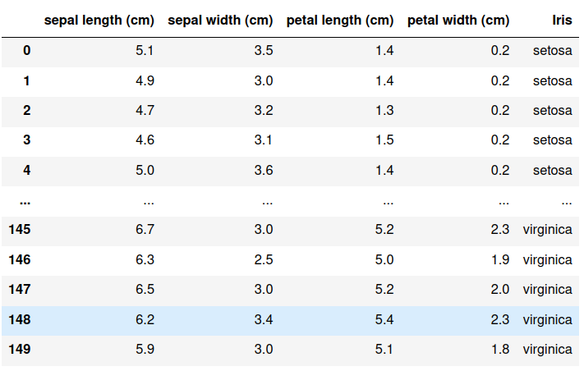
Classification
3 types d’iris (fleurs)

Slide 14
Classification
INPUT: une base de connaissances

Slide 15
Classification
INPUT: une base de connaissances
Caractéristiques (features) (X)
Objectif (target) (y):
une classe (categorie)

Slide 16
Classification
INPUT: une base de connaissances
Quel est le type d’Iris d’une fleur inconnue de longueur de sépale 5,6, de largeur de sépale 2,9 et longueur de pétale 4,7 ?
OBJECTIF: apprendre les liens entre X et y
Étant donnée une nouvelle ligne X, prédire sa classe y

Slide 17
Clustering versus classification
Clustering
Classification

Slide 18
Classification versus clustering
X
X
y
Clustering
Classification

Slide 19
Classification versus clustering
X
X
y
Clustering
Classification
On souhaite trouver des groupes/clusters
On souhaite prédire la classe y

Slide 20
Classification versus clustering
X
X
y
Clustering
Classification
On souhaite trouver des groupes/clusters
=> Apprentissage non-supervisé
On souhaite prédire la classe y
=> Apprentissage supervisé

Slide 21
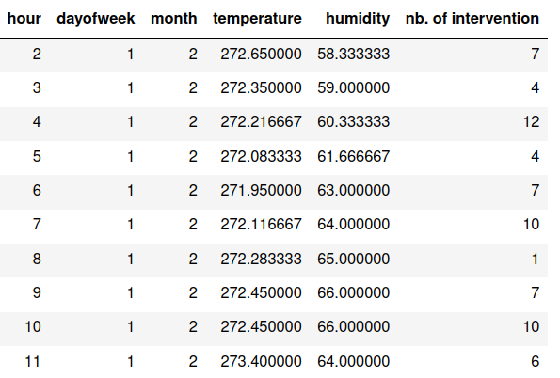
Classification versus régression
X
y
X
y
Classification
Regression
On souhaite prédire la classe y
On souhaite prédire le nombre y
=> y est une catégorie
=> y est un nombre (float, int…)
supervised learning (both)

Slide 22
Arbres de décision pour la régression
Temperature
T>0
T<0
Accidents = 20
Fires = 50
Accidents = 45
Fires = 3

Slide 23
Arbres de décision pour la régression
Temperature
T>0
T<0
Humidity
Accidents = 45
Fires = 3
H<50%
H > 50%
Accidents = 3
Fires = 48
Accidents = 17
Fires = 2

Slide 24
L’IA pour les séries temporelles

Slide 25
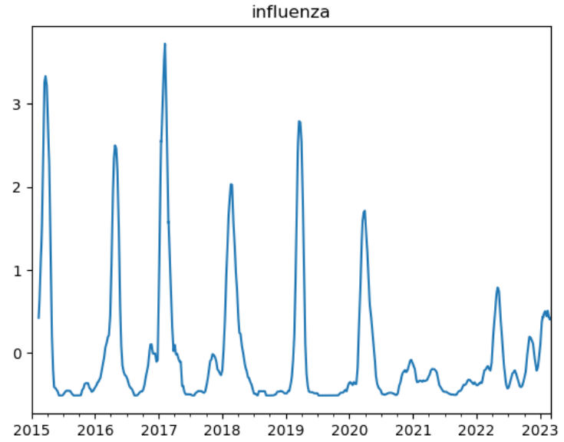
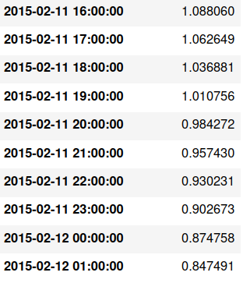
Time series
A set of dates+values

Slide 26
Pas de caractéristiques dans les time series
y

Slide 27
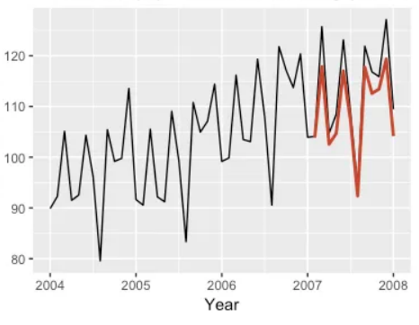
Prédictions de séries temporelles

Slide 28
Time series forecasting how to…
Utilisation de :
La saisonnalité

Slide 29
Time series forecasting how to…
Utilisation de :
La saisonnalité
L’auto-régression

Slide 30
Time series forecasting how to…
Utilisation de :
La saisonnalité
L’auto-régression
La tendance générale
…

Slide 31
L’IA sur les images

Slide 32
Image classification
Apprendre à classifier des images

Slide 33
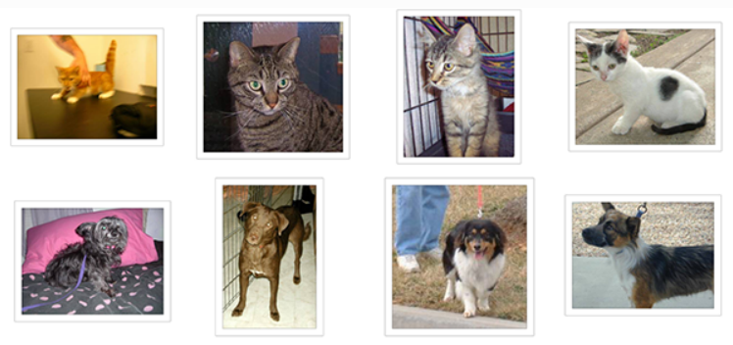
Image classification
Apprendre à classifier des images
Input: Une base de connaissances (images + classe) Méthode: réseau de neurones(CNN)
cat cat cat cat
dog dog dog dog

Slide 34


Amélioration d’images
Input Output
Exemple: débruitage d’image (denoising)

Slide 35
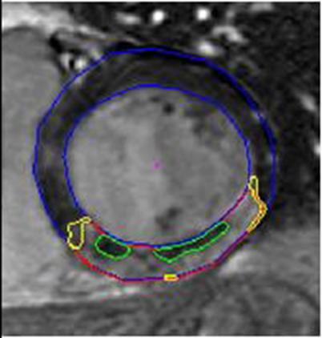
Segmentation d’images
Exemple: infarctus du myocardial
- Apprend à reconnaitre la zone du myocarde
- Apprend à trouver la partie endommagée du muscle cardiaque.
Dataset: des images d’IRM manuellement annotées

Slide 36
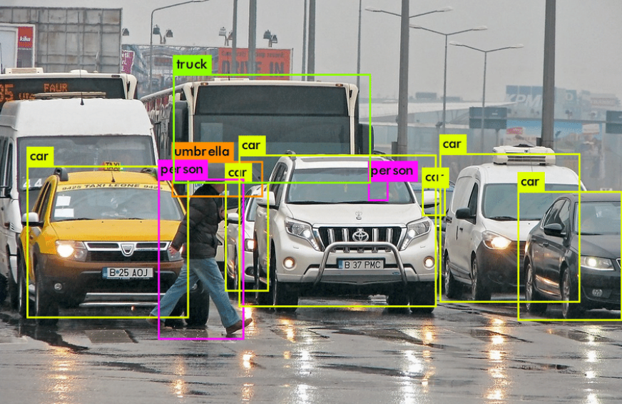
Détection d’objet

Slide 37
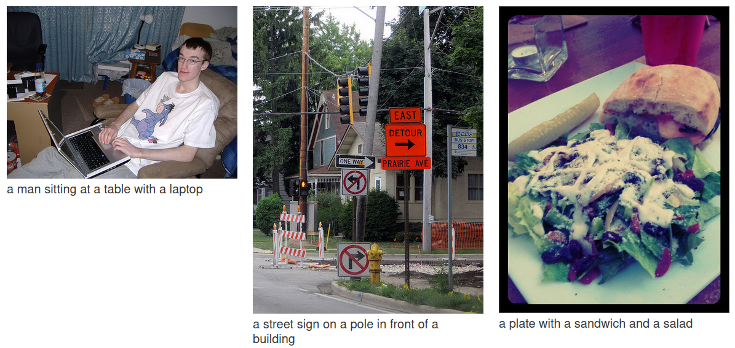
Génération d’images
Output
Input
https://github.com/karpathy/neuraltalk2

Slide 38
Description d’image
Input
Output
https://github.com/karpathy/neuraltalk2

Slide 39
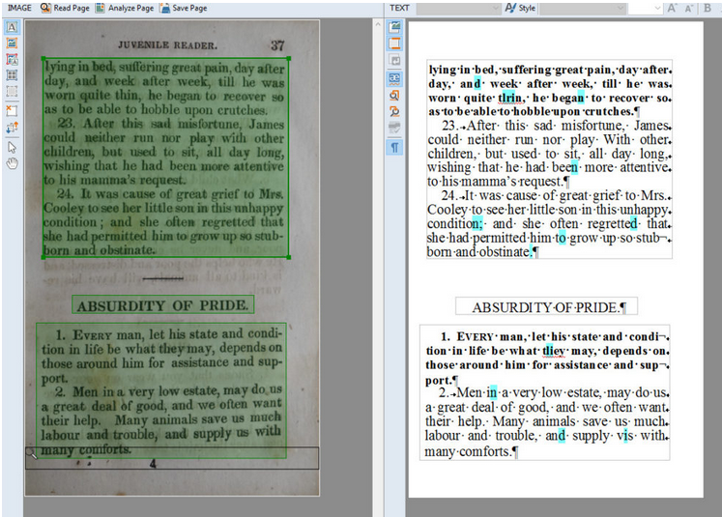

Reconnaissance de texte (OCR)
Numérique ou manuscrit
https://huggingface.co/microsoft/trocr-large-handwritten

Slide 40
L’IA sur les textes

Slide 41

Classification de textes
Exemple: « sentiment analysis » sur des tweets
Également: spam detection, language detection…

Slide 42
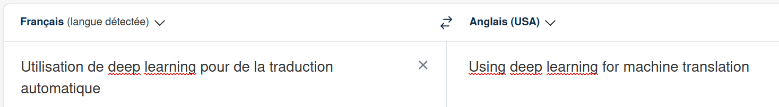
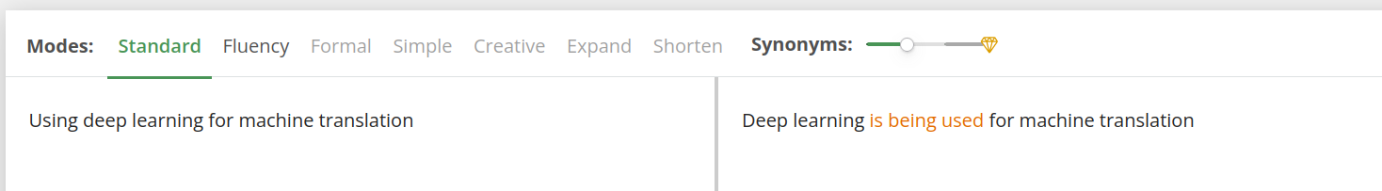
Seq 2 seq mapping
Traduction automatique(deepL)
Paraphrasing (QuillBot)

Slide 43
Également…
Du texte…
… au résumé
… aux mots-clés
… au code
… à la parole
Correction automatique, simplification, disambiguation
Génération de texte: ChatGPT, Gemini…

Slide 44
L’IA sur la parole

Slide 45
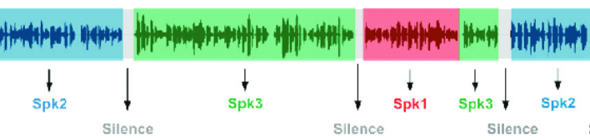
L’IA sur la parole
Sentiment analysis
Speech to text
Diarization :

Slide 46
2. Pandas library

Slide 47
Preparing your working environment

Slide 48
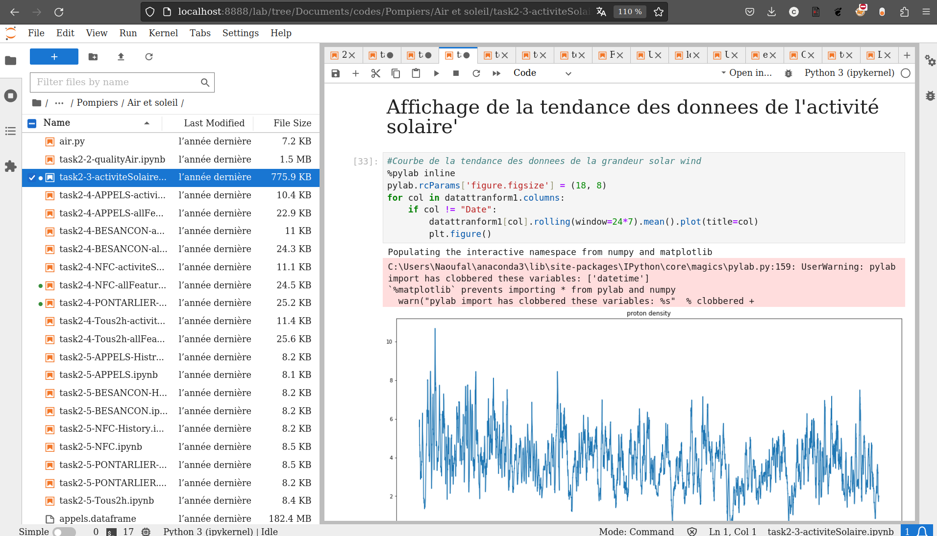
Jupyter notebooks
Jupyter notebook, jupyter-lab, google colaboratory, jupyter-book…
markdown cells
python cells
output cells
pdf/latex/html…

Slide 49
Python environment
python -m venv myenv create
source myenv/bin/activate
pip install pandas
To use it in jupyter-lab:
pip install ipykernel
python -m ipykernel install --user --name=myenv
export / install environment libraries:
pip freeze > requirements.txt
pip install -r requirements.txt

Slide 50
Introducing Pandas

Slide 51
Presentation
Pandas is a practical library to analyze and visualize big data, integrating the functionalities of Numpy and matplotlib.
Pandas defines three data structures:
Series: object labelled in the form of a one-dimensional table, capable of containing any type of object.
DataFrame: a two-dimensional data structure, where columns can be of different types.
Panel: three-dimensional data structure, DataFrames dictionary.
As DataFrames are two-dimensional arrays, they are ideal for CSV files. They correspond to a Series stack whose indexes are shared (and therefore aligned).

Slide 52
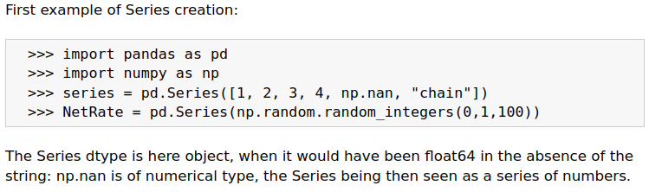
Creation of series

Slide 53
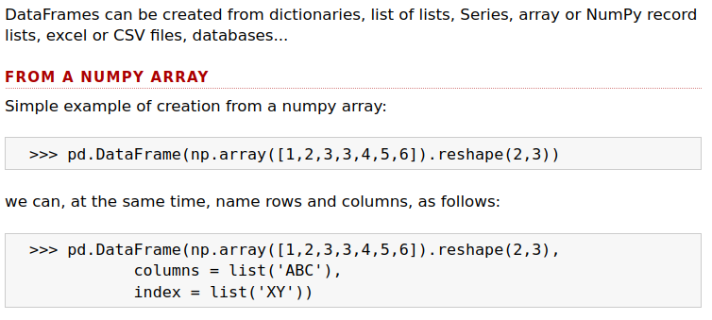
Creation of dataframes

Slide 54
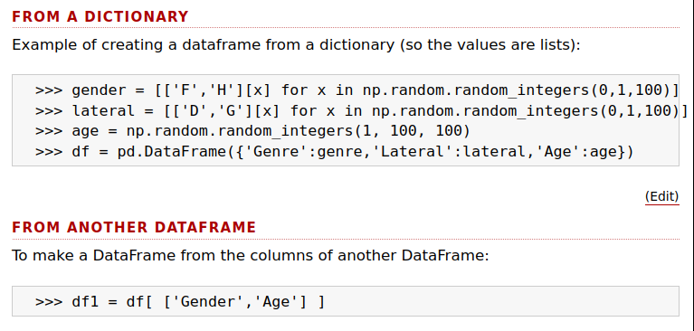
Creation of dataframes

Slide 55
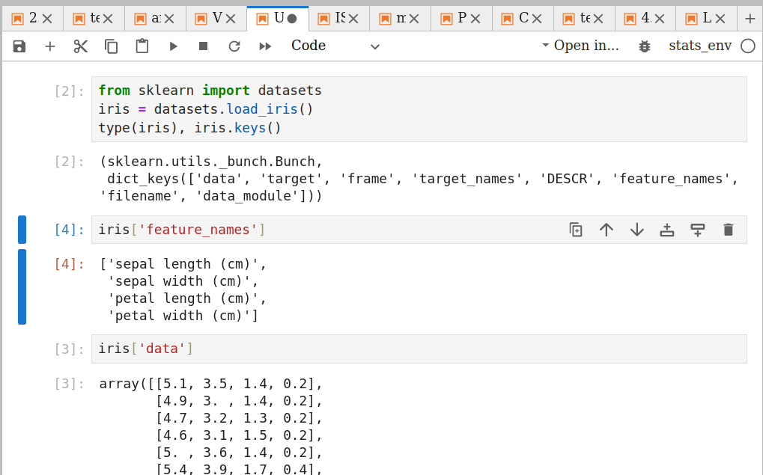
Importing an illustrative dataset

Slide 56
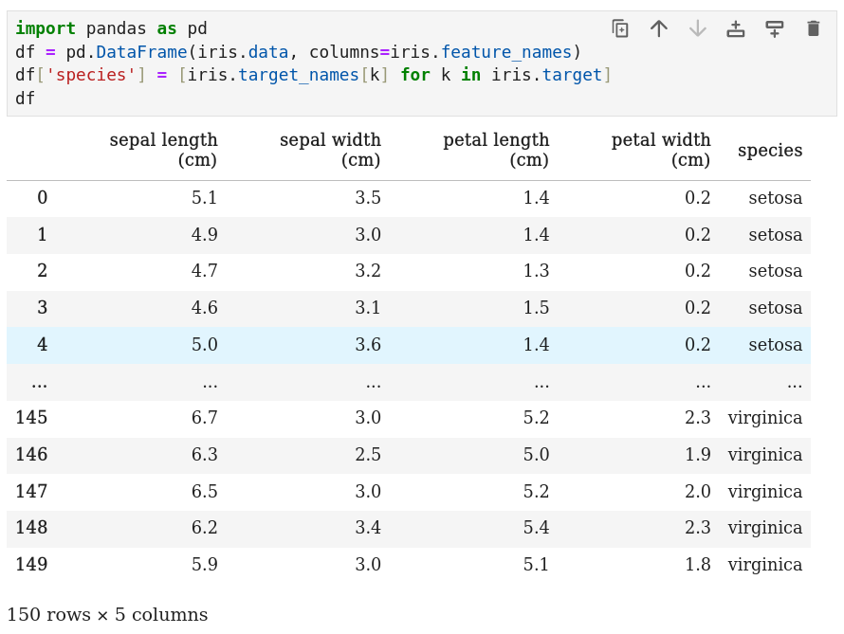
Importing an illustrative dataset

Slide 57
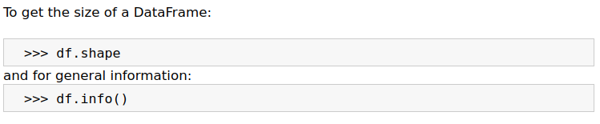
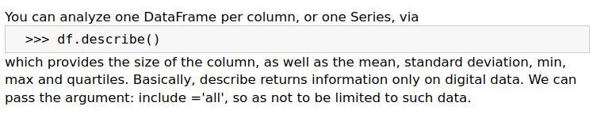
Data information

Slide 58
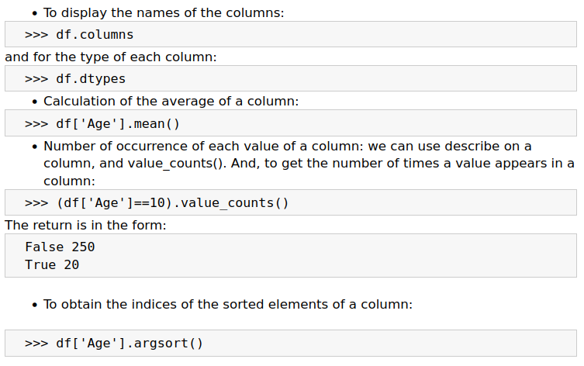
Column information

Slide 59
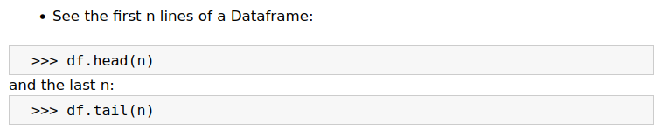
Access to data

Slide 60
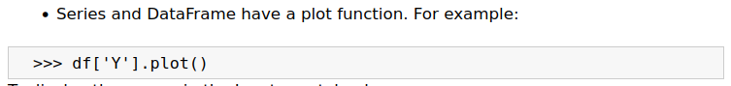
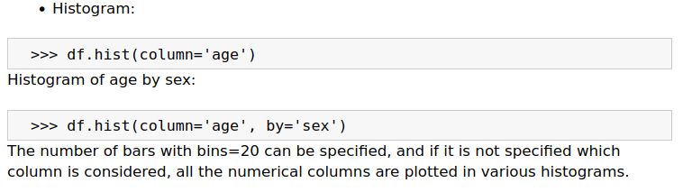
Graphics

Slide 61
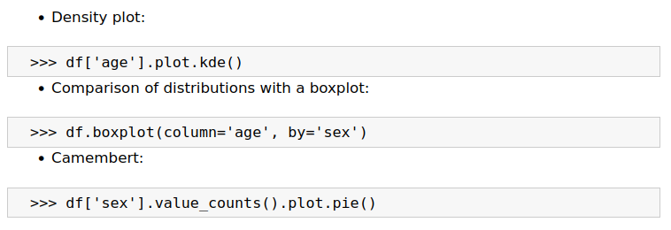
Graphics

Slide 62
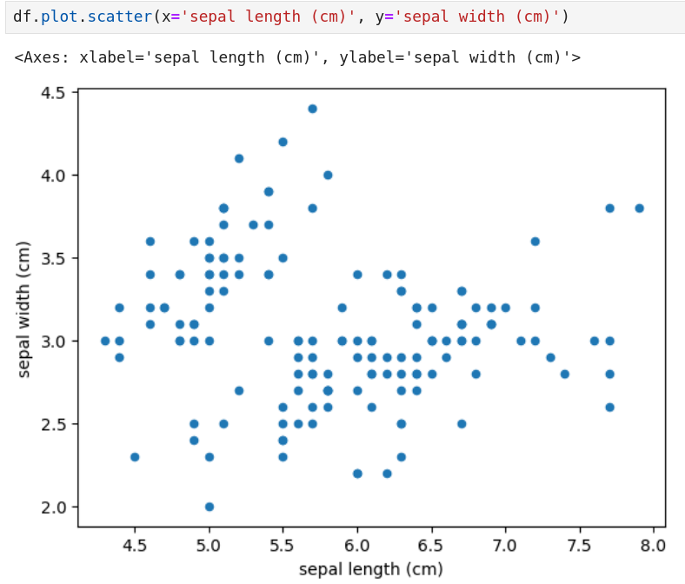
Graphics: point clouds

Slide 63
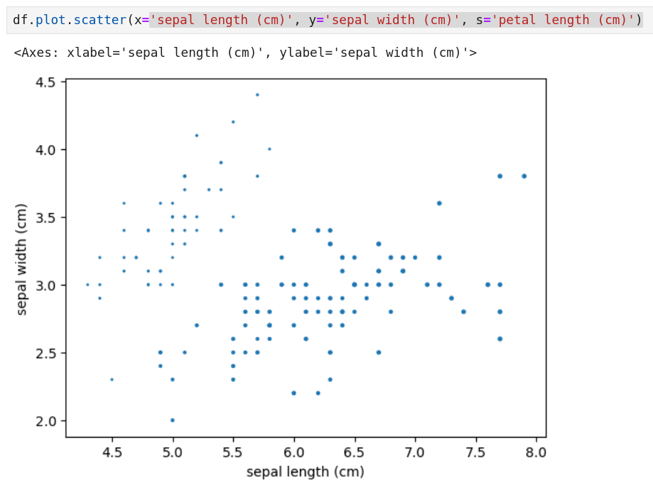
Graphics: point clouds

Slide 64
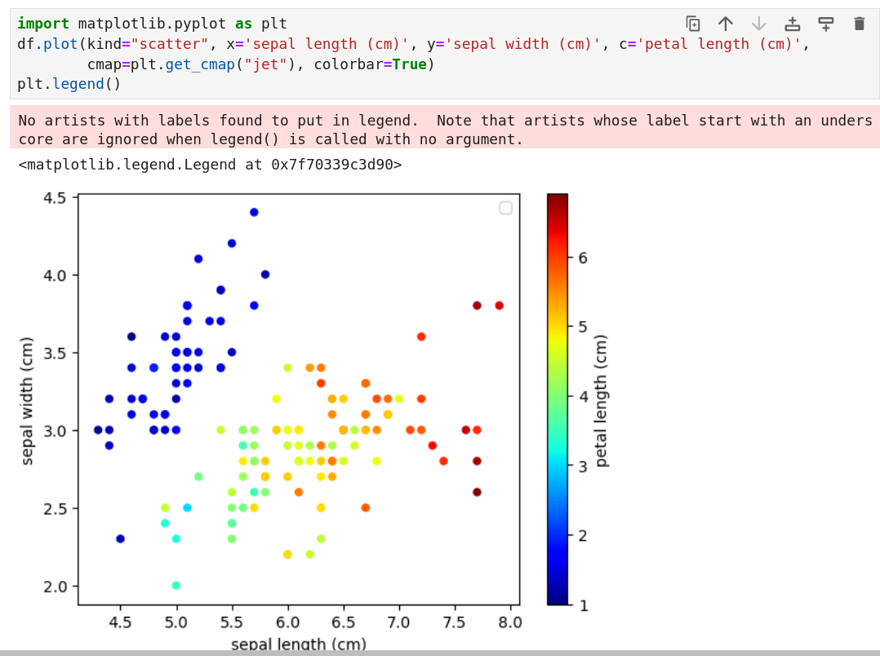
Graphics: point clouds

Slide 65
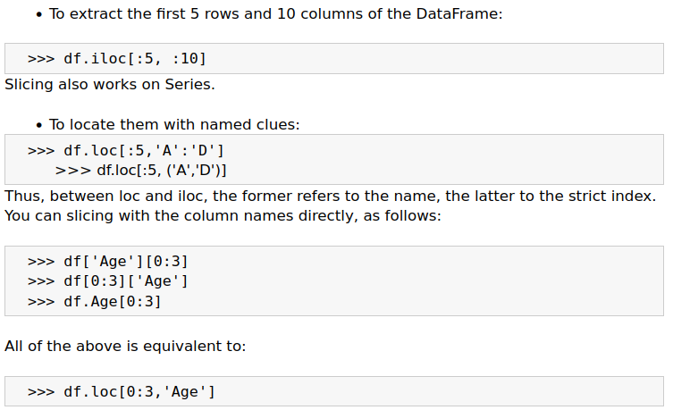
Data location

Slide 66
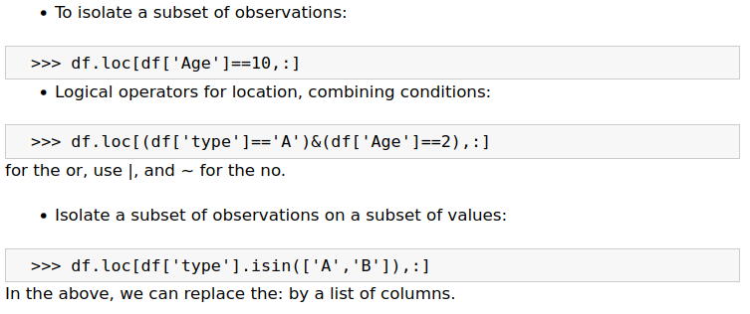
Data location

Slide 67
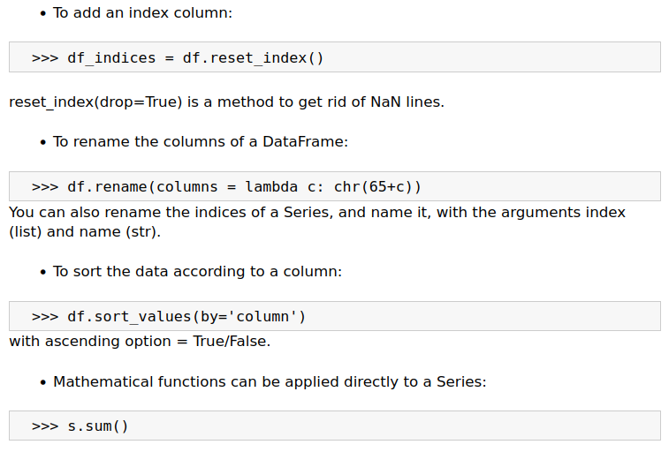
Dataframes modification

Slide 68
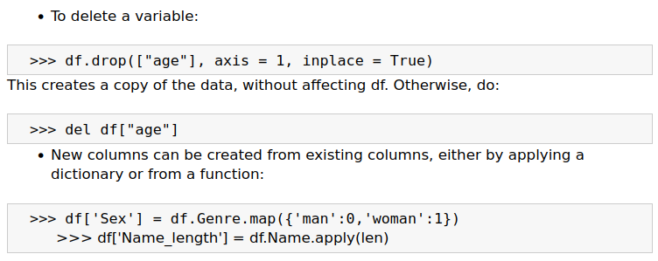
Operations on columns

Slide 69
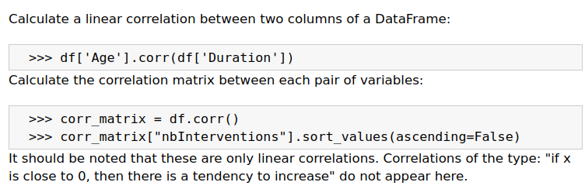
Correlations

Slide 70
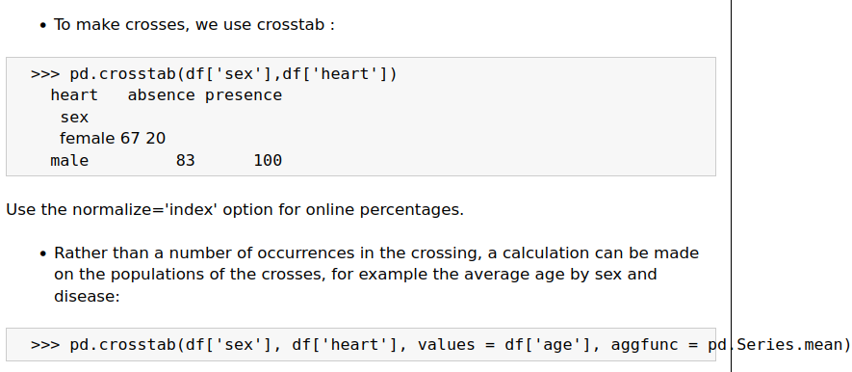
Crosstab

Slide 71
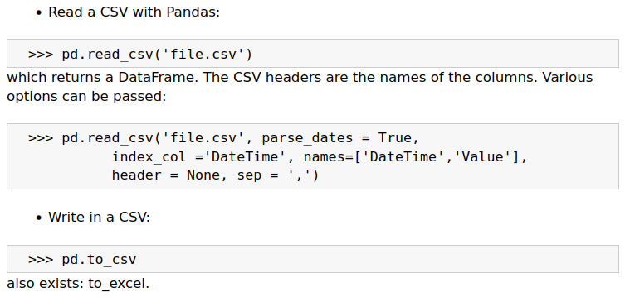
csv files

Slide 72
The practice of pandas

Slide 73
Project
https://www.w3resource.com/python-exercises/pandas/index.php
Do at least 2 exercises per section (up to "Pandas plotting")
Send me a well-documented notebook by email: christophe.guyeux@univ-fcomte.fr

Slide 74
3. Data visualisation
C. Guyeux
Master IoT

Slide 75
Importing an illustrative dataset

Slide 76
Importing an illustrative dataset

Slide 77
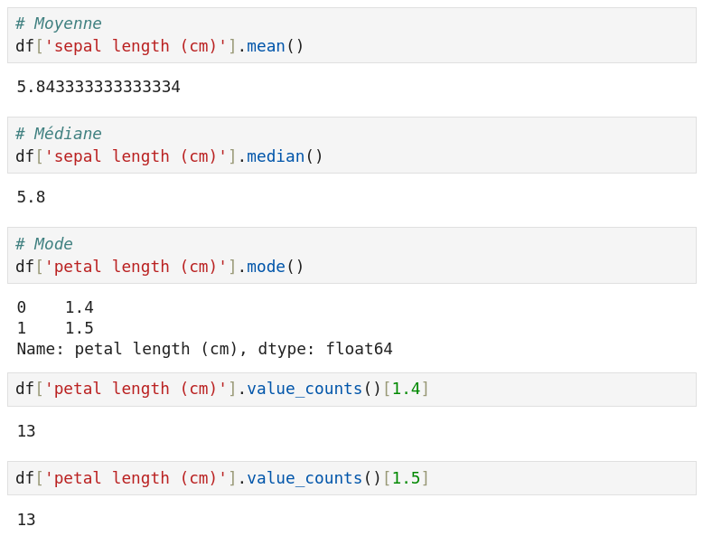
Central tendency measurements

Slide 78
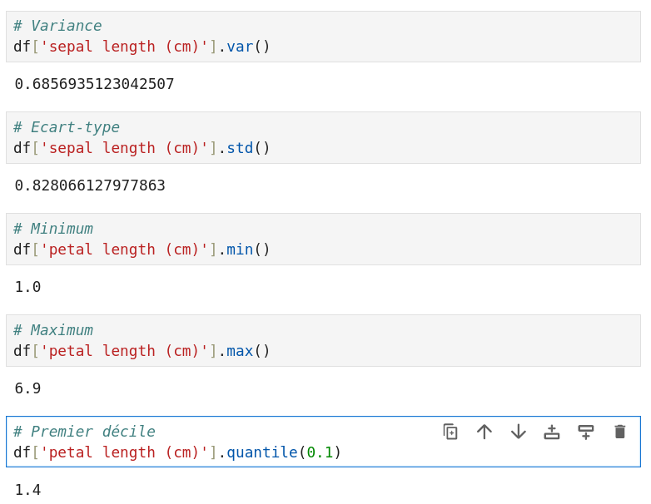
Dispersion measurements

Slide 79
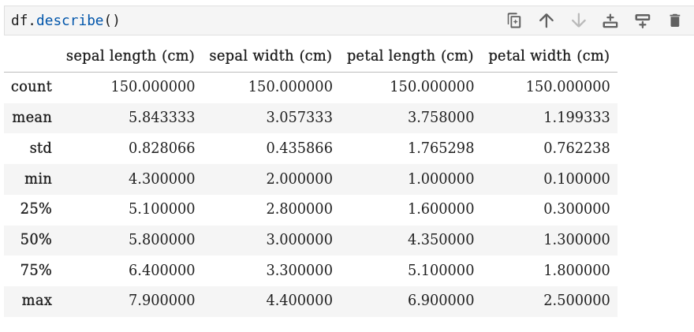
Summary

Slide 80
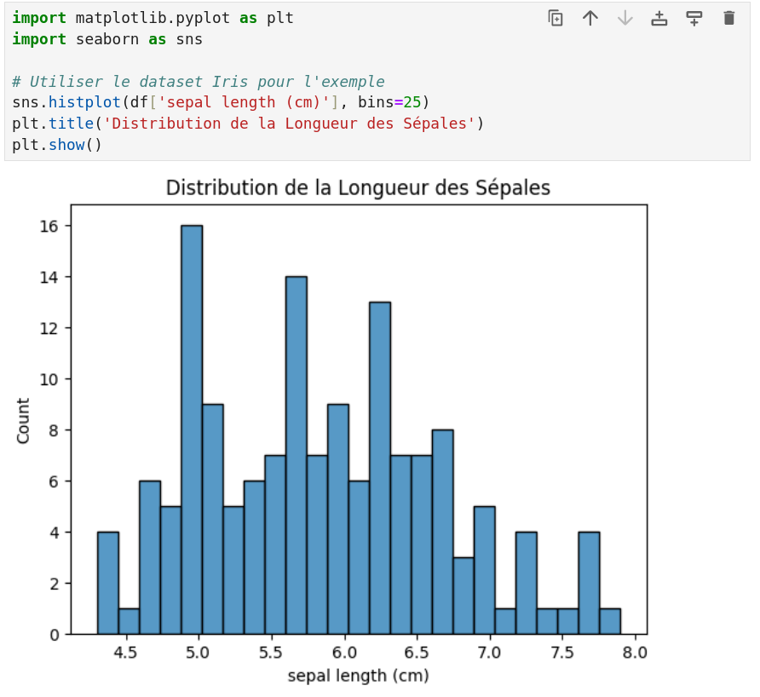
Data distribution
Histograms and boxplots are essential for understanding the distribution of data.
This code generates a histogram of sepal length in the Iris dataset.

Slide 81
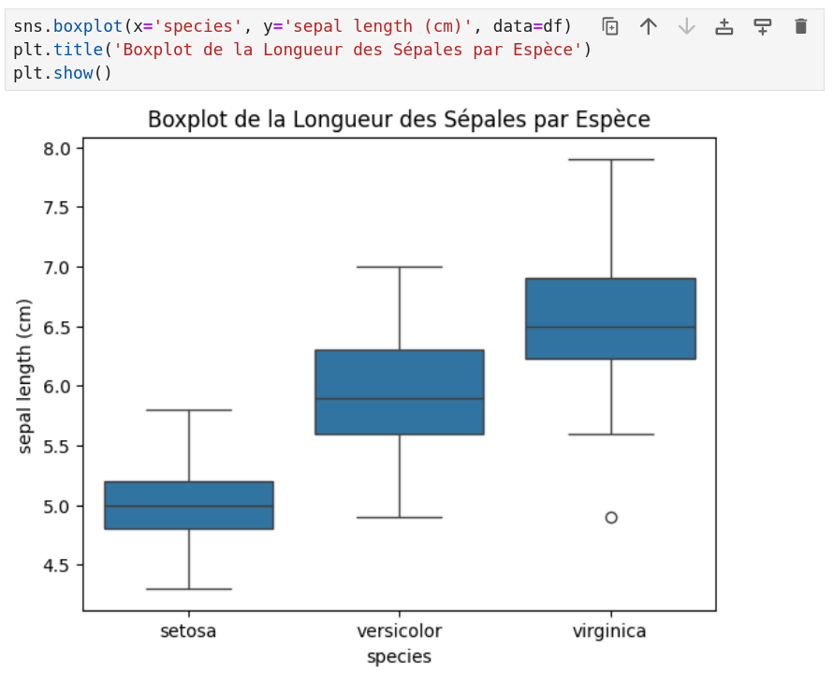
Data distribution
Histograms and boxplots are essential for understanding the distribution of data.
This code creates a boxplot to compare the length of sepals between different iris species.
Q3 + 1.5 * IQR
Q1 - 1.5 * IQR
IRQ : Interquartile interval (Q3-Q1)
1st Q1 & 3rd Q3
quartiles
median
outlier

Slide 82
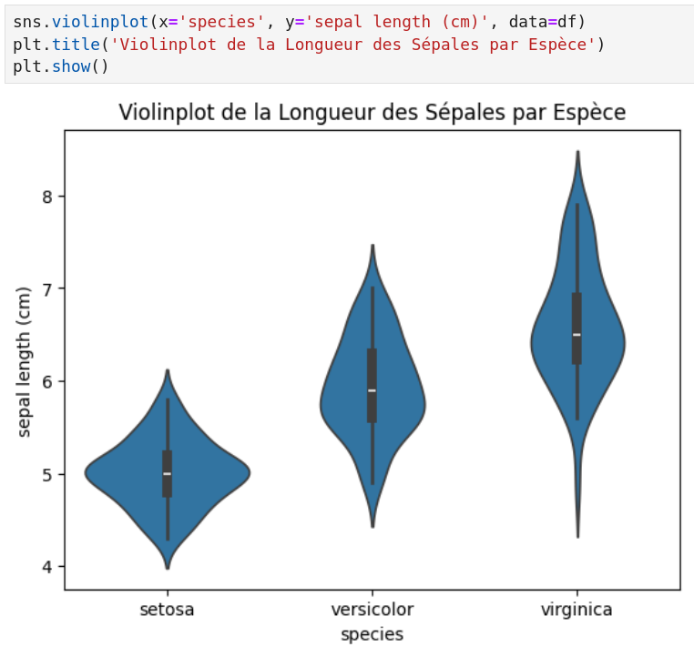
Data distribution: violinplot

Slide 83
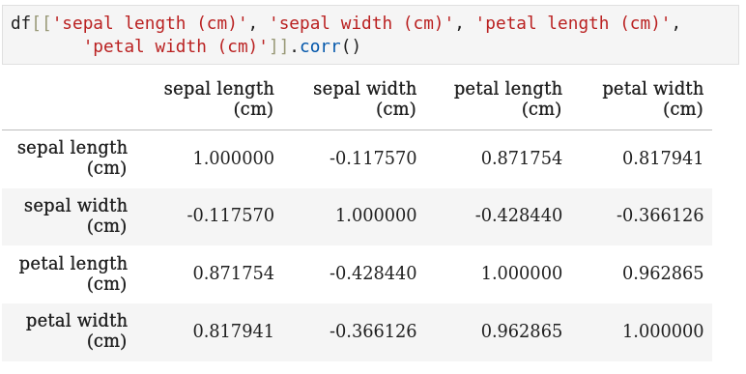
Correlation analysis

Slide 84
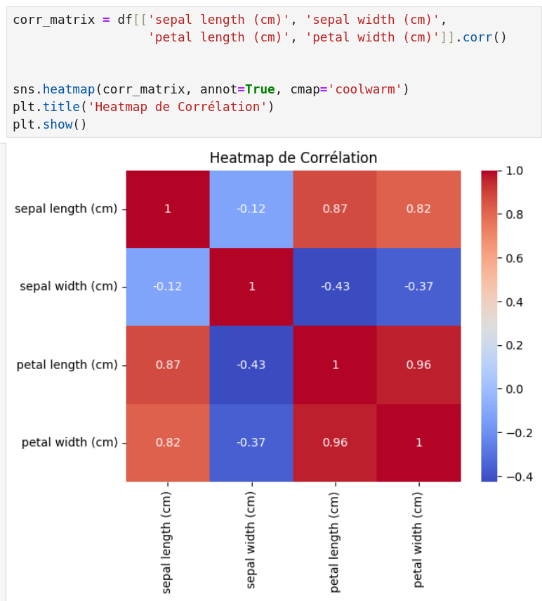
Correlation analysis: heatmap

Slide 85
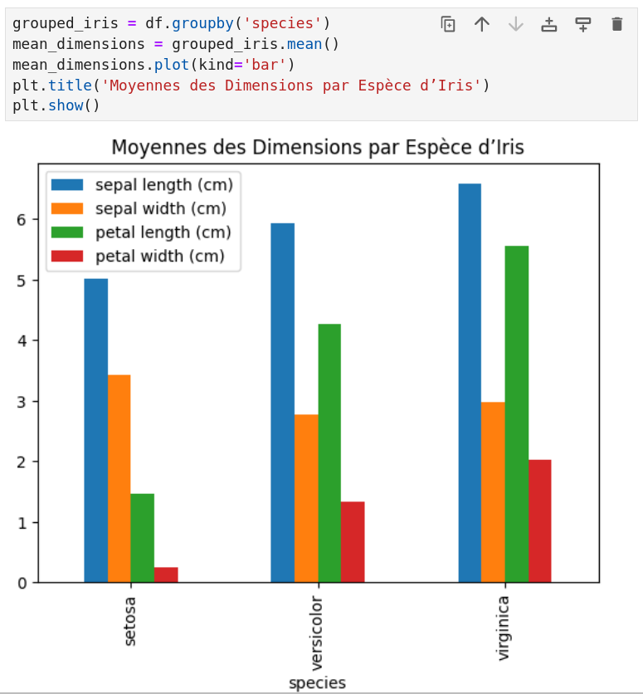
Grouping and aggregation
The Iris dataset can be grouped by species to analyse the characteristics of each group.
This code groups the data by species and calculates the average of each characteristic for each group.
The bar graph shows the average sepal and petal dimensions for each species.
Other ideas: min / max per species, medians…

Slide 86
Project
Use data visualization and descriptive statistics to analyse the scikit-learn breast cancer dataset (start by creating a dataframe).
Do some research on the internet to gain a better understanding of the data by using matplotlib, seaborn, statistics...
Add markdown cells to describe the data : what you see, if there is some outliers, etc.
Do it with other datasets from https://archive.ics.uci.edu/
Send me your project to: christophe.guyeux@univ-fcomte.fr
>>> from sklearn import datasets
>>> data = datasets.load_breast_cancer()
>>> print(data.DESCR)

Slide 87
4. Clustering
C. Guyeux
Master IoT

Slide 88

Clustering ?
Cluster analysis or clustering is the task of grouping a set of objects in such a way that objects in the same group (called a cluster) are more similar (in some sense) to each other than to those in other groups (clusters)

Slide 89

Clustering techniques
K-means

Slide 90
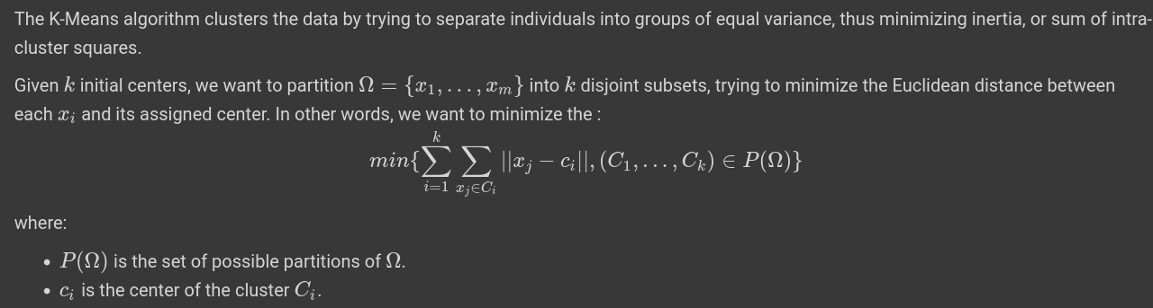
K-Means

Slide 91
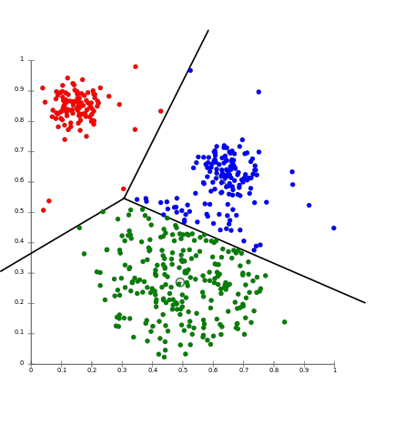

K-Means: illustration

Slide 92

K-Means in python

Slide 93

K-Means: pros & cons

Slide 94
Clustering techniques
Hierarchical clustering

Slide 95

Agglomerative clustering: algorithm

Slide 96

Hierarchical clustering: illustration

Slide 97

Agglomerative cl. in python

Slide 98

Agglomerative cl.: pros & cons

Slide 99
Clustering techniques
Mean-shift

Slide 100

Mean-shift

Slide 101

Mean-shift: algorithm

Slide 102
Mean-shift
An animation of the method : here

Slide 103

Mean-shift in python

Slide 104

Mean-shift: pros & cons

Slide 105
Clustering techniques
others

Slide 106
Other classical clustering
K-Means
Mini Batch K-Means
K-Medoids
K-Modes
Hierarchical clustering
Agglomerative
Divisive
Mean-shift
Nearest neighbors
Birch
DBSCAN / HDBSCAN*
Gaussian Mixture Model
Affinity propagation
…

Slide 107
Constrained clustering
Active semi-supervised clustering algorithms
COP-Kmeans: COP (COnstrained Pairwise) K-Means is a constrained clustering technique, where it is specified that this and that individual must be linked, when that and that other must not.
MinSizeKmeans : forces a minimum size for clusters.
…

Slide 108

Various clustering approaches

Slide 109
Clustering evaluation

Slide 110

Elbow method

Slide 111

Elbow method in practice

Slide 112

Dunn index

Slide 113

Dunn index (python code)

Slide 114

(un)supervised sklearn metrics

Slide 115
Project
Select a clustering dataset from https://archive.ics.uci.edu/
Try various clustering approaches, by playing with the algorithms, their parameters…
Use various evaluation technics to select the most promising clusterings
Plot the data of the selected clusterings, with one color per cluster (may need a Principal Component Analysis)
Send me your project (pdf notebook) to: christophe.guyeux@univ-fcomte.fr

Slide 116
5. Classification
C. Guyeux
Master IoT

Slide 117
Importing a dataset

Slide 118

The Iris dataset

Slide 119

The Iris dataset

Slide 120

The Iris dataset

Slide 121

The Iris dataset

Slide 122

The Iris dataset

Slide 123
Classification with SVM

Slide 124

Data preparation

Slide 125

Class prediction

Slide 126

Accuracy score

Slide 127




Precision, recall, F₁-score
F₁ score : harmonic mean between Precision and Recall
=> for imbalance data (+ stratified train/test split)
>>> from sklearn.metrics import recall_score, precision_score, f1_score

Slide 128

Cross validation

Slide 129
Project
Compare the SVM classification with the ones you can obtain with Decision trees, Random Forests, Stochastic gradient descent, and Neural networks : https://scikit-learn.org/stable/supervised_learning.html#supervised-learning
Select a classification dataset from https://archive.ics.uci.edu/
Try various classification approaches, by playing with the algorithms, their parameters…
Use various evaluation technics to select the most promising classification
Send me your project (pdf notebook) : christophe.guyeux@univ-fcomte.fr

Slide 130
6. Data improvement
C. Guyeux
Master IoT

Slide 131
Data preparation

Slide 132
Outliers & missing data
The first step is to visualize your dataset, and look for outliers or missing data.
The first ones should be discarded, by one of the methods we will explain later.
The second ones are to be completed
for example by 0,
or by the average of the data of the column,
or by making a linear interpolation between the two closest known values, if it makes sense.

Slide 133
Missing data using Pandas
Find columns with missing data for col in df:
df[col].isna().sum()
replace 'mq' by NaNs: df.replace('mq', np.NaN)
Fill/drop NaNs: df['target'].fillna(0) df['target'].fillna(df.target.mean()) df['target'].fillna(method='ffill') # forward fill df['target'].dropna(inplace=True)
df['target'].interpolate() # Linear interpolation

Slide 134
Outliers detection
A rudimentary way of detecting outliers is to look at the gap e between the first and third quartiles, and discard anything below the first quartile -1.5e, and above 1.5e +3rd quartile (as in box plot).
https://pyod.readthedocs.io/en/latest/
from pyod.models.ecod import ECOD
clf = ECOD()
clf.fit(X_train)
# Outlier scores for training data
y_train_scores = clf.decision_scores_
# Outlier scores for test data
y_test_scores = clf.decision_function(X_test)

Slide 135
Data encoding

Slide 136
Data encoding
Once these data are prepared, they must be encoded, which often helps the model to make good predictions.
Columns with numerical values must be normalized,
and other columns (consisting of text, booleans, colors... in short categories), must be encoded as a number or a vector of numbers. This can be done in various ways.
We can for example associate an integer to each category, in a naive way.
We can also do a "one hot encoding": if we have n possible categories, then we will encode it as a binary vector.
Or, finally, transform each category into a real corresponding to the target average for that category ("target encoding")

Slide 137
Numerical encoding with Pandas
Numerical standardization:
from sklearn.preprocessing import StandardScaler
scaler = StandardScaler()
scaler.fit_transform(df[num_col])
=> mean = 0, std = 1

Slide 138
Categorical encoding: Label encoding
>>> from sklearn.preprocessing import LabelEncoder
>>> df = pd.DataFrame(
... [['Male', 'US', 12],
... ['Female', 'US', 37],
... ['Female', 'FR', 22],
... ['Female', 'PL', 22],
... ['Male', 'US', 42]],
... columns=['Gender', 'Country', 'Age'])
>>>
>>> enc = LabelEncoder()
>>> enc.fit_transform(df['Country'])
array([2, 2, 0, 1, 2])

Slide 139
Categorical encoding: One hot encoding
>>> from sklearn.preprocessing import OneHotEncoder
>>> import pandas as pd
>>> df = pd.DataFrame(
... [['Male', 'US', 12],
... ['Female', 'US', 37],
... ['Female', 'FR', 22],
... ['Male', 'US', 42]],
... columns=['Gender', 'Country', 'Age'])
>>>
>>> enc = OneHotEncoder(handle_unknown='ignore')
>>> dd = enc.fit(df[['Gender', 'Country']])
>>> dd.categories_
[array(['Female', 'Male'], dtype=object), array(['FR', 'US'], dtype=object)]

Slide 140
Categorical encoding: One hot encoding
>>> out = dd.transform(df[['Gender', 'Country']])
>>> out.toarray()
array([[0., 1., 0., 1.],
[1., 0., 0., 1.],
[1., 0., 1., 0.],
[0., 1., 0., 1.]])
>>> enc.inverse_transform([[0., 1., 0., 1.],
... [0., 0., 1., 0.]])
array([['Male', 'US'],
[None, 'FR']], dtype=object)
>>> enc.get_feature_names_out(['Gender', 'Country'])
array(['Gender_Female', 'Gender_Male', 'Country_FR', 'Country_US'],
dtype=object)

Slide 141
Categorical encoding: One hot encoding
>>> df[enc.get_feature_names_out(['Gender', 'Country'])] = dd.transform(df[['Gender', 'Country']]).toarray()
>>> df.drop(['Gender', 'Country'], axis=1, inplace=True)
>>> df
Age Gender_Female Gender_Male Country_FR Country_US
0 12 0.0 1.0 0.0 1.0
1 37 1.0 0.0 0.0 1.0
2 22 1.0 0.0 1.0 0.0
3 42 0.0 1.0 0.0 1.0

Slide 142
Categorical encoding: target
Rather than having as many explanatory variables as possible categories, we can transform each category into the average value of the variable to be explained when we are in that category : Target encoding.
If, for example, we consider the day of the year, rather than collecting 365 binary variables, we recover a single variable, the value of which will be greater the higher the value of the target variable on that day.
(pip install category_encoders)
from category_encoders import TargetEncoder
enc = TargetEncoder(cols=['Name_of_col','Another_name'])
training_set = enc.fit_transform(X_train, y_train)

Slide 143
Feature selection

Slide 144
Feature selection
The parameters of the learning algorithms should be set as well as possible, in particular through cross-validation techniques.
Similarly, it is often essential to reduce the number of explanatory variables, by discarding those that have only a very small impact on the variable to be explained. This is called feature selection.
This feature selection can be operated in various ways…

Slide 145
Use of variance
The first option for reducing the number of explanatory variables is to use the variance via the VarianceThreshold object.
Features with a low variance cannot be used to match the variations in a variable to be explained.
To calculate the variance per column, we can use numpy as follows: np.var(X, axis = 1). The variance limit for variable selection can, for example, be set at the median of these variances:
np.median(np.var(X, axis = 1))
The selection process itself can be as follows:
from sklearn import feature_selection
var_limite = feature_selection.VarianceThreshold(np.median(np.var(X, axis=1)))
variables_a_garder = var_limite.fit_transform(X)
The advantage of this variable selection based on the requirement of sufficient variances for the explanatory variables is that it does not require any information on the variable to be explained: it can therefore be applied in the unsupervised case.

Slide 146
Correlation coefficient
Initially, only those variables with the highest absolute correlation with the target can be retained:
def cor_selector(X, y, num_feats):
cor_list = []
feature_name = X.columns.tolist()
# calculate the correlation with y for each feature
for i in X.columns.tolist():
cor = np.corrcoef(X[i], y)[0, 1]
cor_list.append(cor)
# replace NaN with 0
cor_list = [0 if np.isnan(i) else i for i in cor_list]
# feature name
cor_feature = X.iloc[:,np.argsort(np.abs(cor_list))[-num_feats:]].columns.tolist()
# feature selection? 0 for not select, 1 for select
cor_support = [True if i in cor_feature else False for i in feature_name]
return cor_support, cor_feature
cor_support, cor_feature = cor_selector(X, y, num_feats)
print(str(len(cor_feature)), 'selected features')

Slide 147
Univariate feature selection
Univariate feature selection works by selecting the best features based on univariate statistical tests.
>>> from sklearn.datasets import load_iris
>>> from sklearn.feature_selection import SelectKBest
>>> from sklearn.feature_selection import f_classif
>>> X, y = load_iris(return_X_y=True)
>>> X.shape
(150, 4)
>>> select = SelectKBest(f_classif, k=2)
>>> select.fit(X, y)
SelectKBest(k=2)
>>> select.get_feature_names_out()
array(['x2', 'x3'], dtype=object)
>>> select.transform(X)
array([[1.4, 0.2],
[1.4, 0.2], …

Slide 148
Feature importance
Each regression method with a feature_importance method can be used as a variable selection:
from sklearn.ensemble import ExtraTreesClassifier
model = ExtraTreesClassifier()
model.fit(X,y)
print(model.feature_importances_)
feat_importances = pd.Series(model.feature_importances_, index=X.columns)
feat_importances.nlargest(10).plot(kind='barh')
plt.show()

Slide 149
Recursive feature elimination
Recursively, we iterate the training with a given regressor which has a feature_importance method, then delete the least important variable:
from sklearn.feature_selection import RFE
from sklearn.linear_model import LogisticRegression
rfe_selector = RFE(estimator=LogisticRegression(),
n_features_to_select=num_feats,
step=10, verbose=5)
rfe_selector.fit(X_norm, y)
rfe_support = rfe_selector.get_support()
rfe_feature = X.loc[:,rfe_support].columns.tolist()
print(str(len(rfe_feature)), 'selected features')

Slide 150
Boruta
In the feature selection approach, you need to set a threshold, but which one should you choose?
In Boruta, features are not in competition with each other, but with a random version of them.
For each feature, a “shadow” feature is computed by mixing its column.
A Random forest fit both original and shadow feature with y, and feature importance is computed
We only keep original features that are more important than any shadow one
A shadow feature may have a certain importance by chance => the previous stage is performed several times
Features to keep are those that succeeded most of the times
Features to discard are those that failed most of the times
The other ones are in a gray zone.

Slide 151
Boruta
A feature is useful only if it’s capable of doing better than the best randomized feature…
from boruta import BorutaPy
from sklearn.ensemble import RandomForestRegressor
forest = RandomForestRegressor(
n_jobs = -1,
max_depth = 5
)
boruta = BorutaPy(
estimator = forest,
n_estimators = 'auto',
max_iter = 100 # number of trials to perform
)
boruta.fit(np.array(X), np.array(y))
green_area = X.columns[boruta.support_].to_list()
blue_area = X.columns[boruta.support_weak_].to_list()

Slide 152
Project
Improve your previous clustering/classification projects by means of:
data preparation
data encoding
feature selection: https://scikit-learn.org/stable/modules/feature_selection.html
Play with algorithms, parameters, and evaluation metrics

Slide 153
7. Dimensionality reduction
C. Guyeux
Master IoT

Slide 154

Introduction

Slide 155

Principal component analysis

Slide 156

Principal component analysis

Slide 157

Principal component analysis

Slide 158
Kernel PCA

Slide 159

Kernel PCA

Slide 160

Kernel PCA

Slide 161

Kernel PCA

Slide 162
Other methods
Truncated SVD
Factor analysis
t-SNE
Isomap
Multidimentional scaling
Dictionary learning
…

Slide 163
Project
Improve (again !) your previous clustering/classification projects by means of dimensionality reduction
Do it on another clustering dataset from https://archive.ics.uci.edu/
At each time, play with all possibilities: feature encoding and selection, algorithms, parameters, and evaluation metrics…

Slide 164
8. Regression
C. Guyeux
Master IoT

Slide 165
From data to dataframe
From csv:
pd.read_csv(my_csv, sep=";", dtype={"DeptNum": str})
From excel:
pd.read_excel(my_excel)
From python dictionary:
pd.DataFrame.from_dict(my_dict, orient="index")
from pyarrow import feather
df = feather.read_feather(fic)
It is better to specify the type of columns in a DataFrame. Because if Pandas doesn't know the type, it will scan each column to see what type to associate with it (dataframe in memory).

Slide 166
Save a DataFrame
DataFrame -> csv:
df.to_csv('my_file.csv', index=False)
with feather:
df.to_feather('my_file.feather')

Slide 167
Detecting with NaN
Count the NaNs per column:
for k in sorted(df.columns):
if df[k].isna().sum() > 0:
print(k, df[k].isna().sum())
The indices with NaN:
for k in sorted(features.columns):
index = features[k].index[features[k].apply(np.isnan)]

Slide 168
Filling NaN
df.fillna(method='ffill', inplace=True)
ffill: propagate last valid observation forward to next valid
bfill: use next valid observation to fill gap.
df.interpolate()
linearly interpolated values based on adjacent values
df.interpolate(method='polynomial', order=2)

Slide 169
Managing particular columns
Count the number of constant columns (where the number of unique values is 1):
(df.nunique() == 1).sum()
Remove the constant columns:
df = df.loc[:, (df != df.iloc[0]).any()]
Find duplicated indices:
df.index.duplicated().sum()
Drop them:
df.drop_duplicates(subset=['col1, 'col2], keep="first")

Slide 170
Preparing the data: digital ones
Standardising digital data:
from sklearn.preprocessing import StandardScaler
scaler = StandardScaler()
df[num_cols] = scaler.fit_transform(df[num_cols])

Slide 171
Preparing the data: categorical ones
One-hot encoding: creates a new binary column for each unique category in the original column.
pd.get_dummies(df, columns=['A'])
Label encoding: assigns a unique integer to each category in the original column.
from sklearn.preprocessing import LabelEncoder
df['A_encoded'] = LabelEncoder().fit_transform(df['A'])
Target encoding: replacing the original categorical values with their corresponding calculated means.
from category_encoders import TargetEncoder
enc = TargetEncoder(cols=cat_cols)
encoder = enc.fit(df.drop(target, axis=1), df[target])
target_enc = encoder.transform(df.drop(target, axis=1))

Slide 172
Feature selection
Delete low variance columns:
variances = df.var()
high_variance_columns = variances[variances > 0.5].index
df = df[high_variance_columns]
Find columns that are highly correlated with target:
corr = df.corr()
target_corr = corr['target']
corr_threshold = 0.7
columns = target_corr[target_corr.abs()>corr_threshold].index
etc.

Slide 173
Train and test datasets (with validation)
from sklearn.model_selection import train_test_split
train_val_set, test_set = train_test_split(df, test_size=0.2,
random_state=42)
train_set, val_set = train_test_split(train_val_set, test_size=0.2,
random_state=42)
X_train = train_set.drop(target, axis=1)
X_val = val_set.drop(target, axis=1)
X_test = test_set.drop(target, axis=1)
y_train = train_set[target]
y_val = val_set[target]
y_test = test_set[target]

Slide 174
Learning (XGBoost)
reg = xgboost.XGBRegressor(random_state = random_state,
early_stopping_rounds = 15,
learning_rate=0.1,
max_depth = 7,
n_estimators=100000,
min_child_weight=1,
gamma=0,
subsample=0.8,
colsample_bytree=0.8,
n_jobs=-1,
verbosity=0)
reg.fit(X_train, y_train, eval_set = [(X_val, y_val)])

Slide 175
Prediction - evaluation (XGBoost)
from sklearn.metrics import mean_squared_error, mean_absolute_error
y_pred = reg.predict(X_test)
print(f”MAE : {mean_absolute_error(y_test, y_pred)}”)
print(f”MSE : {mean_squared_error(y_test, y_pred)}”)

Slide 176
Improve the prediction score
Cross-validation
Play with hyperparameters
Manually
Grid search
AutoML
Change the model : LightGBM, Random forests, SVM, ADABoost…
Add new features
Better feature selection
etc.

Slide 177
Project
Choose a regression dataset from https://archive.ics.uci.edu/
Perform a complete learning and evaluation project, with all the required steps to obtain good predictions

Slide 178
9. Time series
C. Guyeux
Master IoT

Slide 179
Time series ?
The study of time series consists in the study of time-stamped series of observations of quantities of interest:
t-n: "prior" or "lag time",
t: "current time" or "point of reference".
t+n: "future" or "forecast time".
There are two main types of time series studies:
prediction (time series forecasting): predicting the future evolution of the time series from the knowledge of the past.
analysis (time series analysis): we want to understand the data set: classification or clustering, anomaly detection...

Slide 180
What to predict ?
We can try to predict :
the value of the observation during the next time interval (t+1, "one-step forecasting"),
or for a larger time interval ("multi-step forecasting").
One can also try to predict :
only one observation, such as temperature ("univariate time series"),
or be interested in the prediction of several quantities in parallel ("multivariate time series").
Univariate time series are generally the only ones studied, the multivariate approach being generally much more delicate to deal with.

Slide 181
Data visualization

Slide 182

Reading data

Slide 183

Data discovery

Slide 184

Data discovery

Slide 185

Data discovery

Slide 186

Descriptive statistics

Slide 187

Explanatory variables

Slide 188

Explanatory variables

Slide 189

Explanatory variables

Slide 190

Explanatory variables

Slide 191

Visualization

Slide 192

Visualization by year

Slide 193

Histogram of interventions

Slide 194

Density plot

Slide 195

Per year boxplot

Slide 196

Per month boxplot

Slide 197
Autocorrelation

Slide 198

Lag plot

Slide 199

Lag plots

Slide 200

Autocorrelation

Slide 201

Autocorrelation

Slide 202
Trend and seasonality

Slide 203

Time series decomposition

Slide 204

Seasonal decomposition

Slide 205

Another example

Slide 206

Trend suppression

Slide 207

Seasonal adjustment by modeling

Slide 208

Seasonal adjustment by modeling

Slide 209

Seasonal adjustment by modeling

Slide 210
Time series prediction
The AR model

Slide 211

The autoregression AR model

Slide 212

The autoregression AR model

Slide 213

The autoregression AR model

Slide 214

The autoregression AR model

Slide 215

The autoregression AR model

Slide 216

The autoregression AR model

Slide 217

The AR model: another example

Slide 218
Time series prediction
The ARIMA model

Slide 219

The ARIMA model: how it works

Slide 220

The ARIMA model in practice

Slide 221

The ARIMA model: prediction scores

Slide 222
Project
Choose a time-series dataset from https://archive.ics.uci.edu/
Perform a complete study of this time-series (with no features):
Data visualisation
Time series prediction

Slide 223
9. Statistics for data scientists
C. Guyeux
Master IoT

Slide 224
Programme
“Révisions” :
Bibliothèque random
Notions de probabilités
Statistiques descriptives
Statistiques inférentielles
intervalles de confiance
correlations
tests d’hypothèse

Slide 225
Bibliothèque random
(rappels)

Slide 226
Tirer un nombre au sort
randint(a,b) : Un entier choisit au hasard entre a et b compris.
random() : Un flottant au hasard dans l'intervalle [0 ; 1[.
uniform(a,b) : Un flottant au hasard entre a et b.
>>> from random import *
>>> randint(1,6)
6
>>> random()
0.13056799201357172
>>> uniform(12, 18)
13.47830600345744

Slide 227
choice et shuffle
choice(conteneur) : Tire au hasard un élément dans un conteneur.
shuffle(objet) : Mélange l'objet sur place (il doit être modifiable).
>>> liste = [ "Pierre", "Paul", "Jacques", "Jean", "Aristarque"]
>>> choice(liste)
'Jean'
>>> shuffle(liste)
>>> liste
['Jean', 'Paul', 'Jacques', 'Pierre', 'Aristarque']
>>> choice("abcde")
'd'
>>> shuffle("abcde") # impossible

Slide 228
choices et sample
choices(liste, k=nombre) et sample(liste, k=nombre) :
Tirage de nombre éléments, avec et sans répétition. On peut rajouter des poids.
>>> lettres = ["a" , "b", "c", "d", "e"]
>>> choices(lettres, weights=[3,1,2,1,5], k=30)
['c', 'e', 'e', 'e', 'a', 'c', 'c', 'b', 'e', 'a', 'a', 'a', 'a', 'd', 'e', 'e', 'c', 'a', 'b', 'e', 'e', 'c', 'e', 'b', 'e', 'a', 'e', 'c', 'e', 'c']
>>> sample(lettres, k=3)
['e', 'd', 'a']

Slide 229
seed, pseudo-aléa
seed(graine) : le point de départ de la séquence pseudo-aléatoire
>>> from random import seed, random
>>> seed('ma graine'); [random() for k in range(3)]
[0.28965341828795854, 0.27413576041852683, 0.4736484159118418]
>>> seed('ma graine'); [random() for k in range(3)]
[0.28965341828795854, 0.27413576041852683, 0.4736484159118418]
>>> from os import urandom
>>> seed('ma graine'); [urandom(5) for k in range(3)]
[b'6\xf1\xe2\xbf!', b'\x01`\xf0E\x8a', b'\xd8\x14\xe9\x06\xc2']
>>> seed('ma graine'); [urandom(5) for k in range(3)]
[b'W\xf6\x1es\x8b', b'j\x9b\x0e\r\xd7', b'\x85:5\x03\x94']

Slide 230
reproductibilité => masque jetable
Alice a le message suivant à transmettre : "abc"
Elle le transforme sous forme d'une suite de bits, à partir du code ASCII en octet.
Elle crée un masque jetable à partir de la clé secrète 42
Elle génère autant de bits pseudo-aléatoires que de bits du message, pour faire ce masque
Elle calcule son cryptogramme : le OU exclusif bit à bit entre le message d'origine et le masque.
Elle l'envoie à Bob.
À partir de la clé secrète partagée, Bob génère le même masque.
Il refait le OU exclusif bit à bit entre ce masque et le cryptogramme.
Il retombe sur le message d'origine d'Alice.

Slide 231
Masque jetable : proposition de correction
>>> [ord(k) for k in "abc"]
[97, 98, 99]
>>> [bin(ord(k)) for k in "abc"]
['0b1100001', '0b1100010', '0b1100011']
>>> [bin(ord(k))[2:].zfill(8) for k in "abc"]
['01100001', '01100010', '01100011']
>>> ''.join([bin(ord(k))[2:].zfill(8) for k in "abc"])
'011000010110001001100011'
>>> message = [int(u) for u in ''.join([bin(ord(k))[2:].zfill(8) for k in "abc"])]
>>> message
[0, 1, 1, 0, 0, 0, 0, 1, 0, 1, 1, 0, 0, 0, 1, 0, 0, 1, 1, 0, 0, 0, 1, 1]

Slide 232
Masque jetable : proposition de correction
>>> message
[0, 1, 1, 0, 0, 0, 0, 1, 0, 1, 1, 0, 0, 0, 1, 0, 0, 1, 1, 0, 0, 0, 1, 1]
>>> # Alice calcule son masque
>>> seed(42); masque_alice = [randint(0,1) for _ in message]
>>> masque_alice
[0, 0, 1, 0, 0, 0, 0, 0, 1, 0, 0, 0, 0, 0, 0, 0, 1, 0, 1, 1, 0, 0, 1, 1]
>>> # Alice masque son message (chiffrement symétrique)
>>> cryptogramme = [k[0]^k[1] for k in zip(message, masque_alice)]
>>> cryptogramme
[0, 1, 0, 0, 0, 0, 0, 1, 1, 1, 1, 0, 0, 0, 1, 0, 1, 1, 0, 1, 0, 0, 0, 0]
>>> # Elle l'envoie à Bob

Slide 233
Masque jetable : proposition de correction
>>> #Bob calcule le même masque
>>> seed(42); masque_bob = [randint(0,1) for _ in cryptogramme]
>>> masque_bob
[0, 0, 1, 0, 0, 0, 0, 0, 1, 0, 0, 0, 0, 0, 0, 0, 1, 0, 1, 1, 0, 0, 1, 1]
>>> masque_alice
[0, 0, 1, 0, 0, 0, 0, 0, 1, 0, 0, 0, 0, 0, 0, 0, 1, 0, 1, 1, 0, 0, 1, 1]
>>> dechiffré = [k[0]^k[1] for k in zip(masque_bob, cryptogramme)]
>>> dechiffré == message
True

Slide 234
Exercice
Affichez une liste de 200 nombres entiers aléatoires compris entre 5 et 17.

Slide 235
Exercice
Affichez une liste de 200 nombres entiers aléatoires compris entre 5 et 17.
>>> import random
>>> nombres_aleatoires = [random.randint(5, 17) for _ in range(200)]

Slide 236
Exercice
Faire un programme qui crée une liste de 100 résultats aléatoires parmi "Pierre", "Ciseaux" et "Feuille".

Slide 237
Exercice
Faire un programme qui crée une liste de 100 résultats aléatoires parmi "Pierre", "Ciseaux" et "Feuille".
>>> import random
>>> random.choices(['Pierre', 'Ciseaux', 'Feuille'], k=100)

Slide 238
Rappels de probabilités
(pour informaticiens)

Slide 239



Variable aléatoire
Une variable aléatoire associe des nombres aux résultats d'une expérience aléatoire.
Son support est l’ensemble des valeurs qu’elle peut prendre
Lancer d’une pièce -> {0,1} (fini)
Lancer d’un dès -> {1, 2, …, 6}
Somme du lancer de 2 dès : {2, 3, …, 12}
Tirage uniforme d’un entier : ℕ (infini, discret)
Tirage uniforme d’un réel dans [0, 1] (infini, continu)
Sa loi de probabilité décrit la répartition des valeurs que cette dernière peut prendre.
Elle peut être explicitée par…
une fonction de masse :
une densité de probabilité :

Slide 240
Loi de Bernoulli b(p)
Toute expérience aléatoire dans laquelle l’issue possible est binaire (P/F, succès/échec)
P(X=0) = p ∊[0,1], P(X=1) = 1-p
Pour obtenir la probabilité d'obtenir 0 avec un paramètre p=0,5, on utilise la pmf (probability mass function) :
>>> from scipy import stats
>>> p = 0.5
>>> bernoulli = stats.bernoulli(p)
>>> bernoulli.pmf(0)
0.5
et la méthode rvs (random variates) pour tirer k nombres suivant cette loi :
>>> bernoulli.rvs(10)
array([0, 0, 0, 1, 0, 0, 0, 1, 1, 0])

Slide 241

Loi binomiale B(n,p)
k succès dans n tentatives type Bernouilli (ex : 4 piles en 5 lancers) : X ↝ B (5; 0,5), P(X=4) ?
>>> binomial = stats.binom(5, 0.5)
>>> binomial.pmf(4)
0.15625
Vérification :
>>> from math import factorial
>>> C = lambda n,k: factorial(n) / (factorial(k) * factorial(n-k))
>>> n, p = 5, 0.5
>>> [C(n,k)*p**k*(1-p)**(n-k) for k in range(n+1)]
[0.03125, 0.15625, 0.3125, 0.3125, 0.15625, 0.03125]

Slide 242
Loi binomiale : exercice
En Italie, une femme sur 4 est sans enfant.
Quelle est la probabilité pour que, dans une fratrie de 5 soeurs, 4 d’entre-elles n’aient pas d’enfant ?

Slide 243
Loi binomiale : exercice
En Italie, une femme sur 4 est sans enfant.
Quelle est la probabilité pour que, dans une fratrie de 5 soeurs, 4 d’entre-elles n’aient pas d’enfant ?
>>> from scipy import stats
>>> binomial = stats.binom(5, 0.25)
>>> binomial.pmf(4)
0.014648437499999998

Slide 244

Loi géométrique G (p)
Loi du nombre X d'épreuves de Bernoulli indépendantes b(p) nécessaire pour obtenir le premier succès :
Ex : obtenir le premier 2 au cinquième lancer d’un dé à 6 faces
=> p = ⅙, k=5
>>> geom = stats.geom(1/6)
>>> geom.pmf(1)
0.16666666666666666
>>> geom.pmf(5)
0.08037551440329219
Ex : probabilité de désintégration d'une particule radioactive

Slide 245
Loi géométrique G (p) : exercice
Probabilité d’obtenir le premier nombre pair au quatrième lancer d’un dé à 6 faces ?

Slide 246
Loi géométrique G (p) : correction
Probabilité d’obtenir le premier nombre pair au quatrième lancer d’un déà 6 faces ?
>>> geom = stats.geom(1/2)
>>> geom.pmf(4)
0.0625

Slide 247

Lois continues : densité de probabilités
Une variable aléatoire réelle X est dite à densité s'il existe une fonction f positive et intégrable sur R, appelée fonction de densité, telle que :
Décrit comment les probabilités sont réparties sur l'ensemble des valeurs possibles.
=> f(x) donne la probabilité relative de trouver la variable aléatoire X à proximité de la valeur spécifique x (“P(X ∊ [t, t+dt]) = f(t) dt”).

Slide 248



Espérance
Variable…
Discrète, nb fini de valeurs Discrète, nb infini Continue, à densité
Il s’agit de :
Moyenne des valeurs pondérées par les probabilités
La moyenne des valeurs obtenues si l'on répète un grand nombre de fois la même expérience aléatoire (gain moyen espéré).
Loi des grands nombres : si elle existe, c'est la limite presque-sûre de la moyenne des résultats au cours de plusieurs expériences, quand leur nombre augmente à l'infini.

Slide 249


Variance, écart-type
Variable…
Discrète Continue, à densité
Il s’agit de la moyenne des carrés des écarts à la moyenne : une mesure de dispersion.
Ecart-type : sa racine carrée.

Slide 250


Loi normale N (𝜇,𝜎)
Loi continue dont la densité de probabilité a la célèbre “forme en cloche” :
Les observations éloignées de la moyenne sont moins fréquentes,
il y a autant d’observations en-dessous qu’au-dessus de la moyenne.
Ses paramètres : moyenne 𝜇 (espérance), écart-type 𝜎
Exemples :
Erreurs de mesure (Gauss)
Taille des individus (dans une première approximation)
Résidus dans un apprentissage réussi…

Slide 251


Loi uniforme U(a,b) sur [a, b]
Biais de l'équiprobabilité : confondre les notions d'aléatoire et d'uniforme
(toutes les valeurs de 2, 3, …, 12 ne sont pas équiprobables dans un lancer de 2 dés)

Slide 252



Fonction de répartition
La fonction de répartition d’une variable aléatoire réelle X est :
On a alors :
Si X a une densité de probabilité f_{X}, alors :
C’est (en gros) la primitive de la densité de proba,
Et on “somme” cette dernière, de -∞ à x, pour obtenir P(X ≤ x).

Slide 253
Tirage simple : cas d’une loi continue
Dans le cas d'une loi continue, on utilise :
la fonction de répartition F (cumulative distribution function cdf) P(a < X < b) = F(b) - F(a)
la méthode rvs(size=k) pour générer k nombres suivant cette loi.
>>> from scipy import stats
>>> normal = stats.norm(0, 1)
>>> normal.cdf(0.2) - normal.cdf(-0.25) #P(-0.25<X<0.2)
0.1779660351220267
>>> normal.rvs(size=4)
array([-0.075312, 0.0319062, 1.58006291, -0.36757176])

Slide 254
Loi normale : exercice
En supposant que les hommes ont une taille moyenne de 1,73 m. avec un écart-type de 8 cm, et que ces tailles puissent se modéliser à l’aide d’une loi normale, quelle est la probabilité d’avoir un individu ayant une taille entre 1,70m et 1,80m ?

Slide 255
Loi normale : exercice
En supposant que les hommes ont une taille moyenne de 1,73 m. avec un écart-type de 8 cm, et que ces tailles puissent se modéliser à l’aide d’une loi normale, quelle est la probabilité d’avoir un individu ayant une taille entre 1,70m et 1,80m ?
>>> from scipy import stats
>>> va = stats.norm(1.73, 0.08)
>>> va.cdf(1.8)-va.cdf(1.7)
0.45538281382021356

Slide 256
Fonction quantile
La fonction quantile (percent point function ppf) est l’inverse de la fonction de répartition : Q = F⁻¹.
La médiane est Q(0,5),
le premier quartile : Q(0,25)
le premier décile : Q(0,1)...
>>> normal = stats.norm(0, 1)
>>> normal.ppf(0.25)
-0.6744897501960817
>>> normal.ppf(0.5)
0.0

Slide 257
Exercice
Supposons que la taille des femmes suit une loi normale d'espérance 163cm et d'écart-type 6cm. On choisit une femme au hasard.
Quelle est la probabilité que cette femme mesure moins de 157cm?
Quelle est la probabilité que cette femme mesure plus de 175cm?
Quelle est la probabilité que cette femme mesure entre 145 et 181cm?
Quels sont les premier et troisième quartiles de cette distribution?
Tracer la fonction de répartition de cette distribution.

Slide 258
Correction
>>> from scipy import stats
>>> va = stats.norm(163, 6)
>>> va.cdf(157) # P(X < 157)
0.15865525393145707
>>> va.cdf(181) - va.cdf(145) # P(145 < X < 181)
0.9973002039367398
>>> va.ppf(0.25) # premier quartile
158.9530614988235
>>> va.ppf(0.75) # troisième quartile
167.0469385011765

Slide 259

Correction : fonction de répartition
import numpy as np
import matplotlib.pyplot as plt
x = np.linspace(mu - 4*sigma, mu + 4*sigma, 1000)
cdf = norm.cdf(x, mu, sigma)
plt.figure(figsize=(10, 6))
plt.plot(x, cdf, label='Fonction de répartition (CDF)')
plt.title('Fonction de répartition pour la taille des femmes')
plt.xlabel('Taille (cm)')
plt.ylabel('Probabilité cumulée')
plt.grid(True)
plt.legend()
plt.show()

Slide 260


Loi de Poisson P(λ)
Modélise :
tout processus de comptage
le nombre de fois qu'un événement rare et indépendant se produit dans un intervalle fixe :
de temps :
nombre de voitures passant sur un pont en une heure,
nombre d’appels reçus au 112 chaque jour,
d’espace…
nombre de pannes dans une certaine zone d'une machine...
Espérance = Variance = λ (si tel n’est pas le cas, changer de loi)
=> Si on veut simuler un nombre d’appels moyens de 12 appels / heure, alors X ↝ P (12),
et probabilité d’avoir 3 appels en 1h :

Slide 261
Exercice
Lors d’une marche le long d’un sentier de montagne, on croise en moyenne 2 marcheurs toutes les heures.
Quelle est la probabilité d’en croiser 5 au cours d’une heure ?
(utiliser stats.poisson)

Slide 262
Exercice : solution
Lors d’une marche le long d’un sentier de montagne, on croise en moyenne 2 marcheurs toutes les heures.
Quelle est la probabilité d’en croiser 5 au cours d’une heure ?
(utiliser stats.poisson)
>>> from scipy import stats
>>> va = stats.poisson(2)
>>> va.pmf(5)
0.03608940886309672

Slide 263
Exercice
Par quelle loi modéliser les événements suivants :
Le poids d’un individu.
La probabilité pour un étudiant d’aller jusqu’au doctorat.
Le nombre de clients arrivant chaque heure à une caisse de supermarché.
L’obtention de cinq Piles dans 10 lancers d’une pièce.
Le tirage d’un réel entre 2 et 3.

Slide 264

Loi exponentielle(λ)
Modélise la durée de vie d'un phénomène sans mémoire, vieillissement ou usure.
proba que le phénomène dure au moins s+t heures sachant qu'il a déjà duré t heures = proba de durer s heures à partir de sa mise en fonction initiale (une ampoule peut “claquer”, de la même manière, peu après son achat ou au bout de deux ans : taux de défaillance constant au cours du temps)
=> le fait que le phénomène ait duré t heures ne change rien à son espérance de vie à partir du temps t (la probabilité d'un événement dans le futur est indépendante de l'histoire passée)
Espérance = 1/λ : taux moyen d'événements par unité de temps. Variance = 1/λ²
NB : si mémoire, vieillissement ou usure, alors loi de Weibull

Slide 265
Loi exponentielle(λ) : exemples
Probabilité (cumulée) qu'un client soit servi en moins de 5 minutes dans un supermarché, sachant qu’on attend en moyenne 10 minutes Espérance = 0.1 / min = 1/λ
>>> from scipy.stats import expon
>>> expo = stats.expon(scale=10)
>>> expo.cdf(5)
0.3934693402873666

Slide 266
Loi exponentielle(λ) : exercice
Quelle est la probabilité d’avoir un bus ces 10 prochaines minutes, sachant que l’on a en moyenne un bus par heure ?

Slide 267
Loi exponentielle(λ) : correction
Quelle est la probabilité d’avoir un bus ces 10 prochaines minutes, sachant que l’on a en moyenne un bus par heure ? Espérance = 1/6 pour 10 min = 1/λ
>>> from scipy.stats import expon
>>> expo = stats.expon(scale=6)
>>> expo.cdf(1)
0.15351827510938593

Slide 268
Loi exponentielle(λ) : exemple
Temps entre événements dans un processus de Poisson, par exemple entre deux appels téléphoniques (se produisent de manière indépendante à un taux constant).
Supposons que l’on reçoive 5 appels par heure, soit 5/60 par minute (λ=60/5=12). On veut générer 4 appels… >>> from scipy import stats >>> va = stats.expon(60/5) >>> va.rvs(4) array([12.06651968, 14.64844266, 12.01971243, 12.53505665])

Slide 269
D’autres lois existent…
Loi de Gumbel :
niveau des crues d'un fleuve, si on possède le relevé des débits sur dix ans
probabilité d'un événement critique, comme un tremblement de terre
Loi de Fréchet : événements extrêmes tels que le maximum annuel des précipitations journalières ou le débit des rivières
Loi Gamma : analyse de survie
temps restant avant la mort pour des organismes biologiques
temps restant avant l'échec ou la panne dans les systèmes artificiels
Loi de Rayleigh : distance à laquelle une particule se trouve de son point de départ, après avoir effectué n pas d'une marche aléatoire dans le plan
Loi de Laplace, de Benford… https://fr.wikipedia.org/wiki/Liste_de_lois_de_probabilit%C3%A9

Slide 270
Statistiques descriptives

Slide 271
Introduction
Les statistiques descriptives résument et décrivent les caractéristiques d'un jeu de données.
Elles fournissent une compréhension initiale des données, essentielle pour des analyses plus approfondies.
Bibliothèques utiles : Pandas (NumPy), Scikit-learn, Matplotlib, et Seaborn…

Slide 272
Configuration de l'Environnement Python
python -m venv stats_env create
source stats_env/bin/activate
pip install pandas scikit-learn
Pour l'avoir ensuite dans jupyter-lab :
pip install ipykernel
python -m ipykernel install --user --name=stats_env
exporter / installer les bibliothèques d’un environnement :
pip freeze > requirements.txt
pip install -r requirements.txt

Slide 273
Importation d’un dataset illustratif

Slide 274
Importation d’un dataset illustratif

Slide 275
Mesures de tendance centrale

Slide 276
Mesures de dispersion

Slide 277
Résumé

Slide 278
Visualisation de la distribution des données
Les histogrammes et les diagrammes en boîte (boxplots) sont essentiels pour comprendre la distribution des données.
Ce code génère un histogramme pour la longueur des sépales dans le dataset Iris.

Slide 279
Visualisation de la distribution des données
Les histogrammes et les diagrammes en boîte (boxplots) sont essentiels pour comprendre la distribution des données.
Ce code crée un boxplot pour comparer la longueur des sépales entre les différentes espèces d'iris.
Q3 + 1.5 * IQR
Q1 - 1.5 * IQR
IRQ : Intervalle Interquartile (Q3-Q1)
1er Q1 & 3ème Q3
quartiles
médiane
“outlier”

Slide 280
Distribution des données : violinplot

Slide 281
Analyse de corrélation

Slide 282
Analyse de corrélation : heatmap

Slide 283
Groupement et agrégation
Le dataset Iris peut être groupé par espèces pour analyser les caractéristiques de chaque groupe.
Ce code groupe les données par espèce et calcule la moyenne de chaque caractéristique pour chaque groupe.
Le graphique en barres montre les moyennes des dimensions sépales et pétales pour chaque espèce.
Autres idées : min / max par espèce, médianes…

Slide 284
Exercice
Utiliser les statistiques descriptives pour analyser le jeu de données du diabète de scikit-learn (commencer par en faire un dataframe) :
>>> from sklearn import datasets
>>> data = datasets.load_breast_cancer()
>>> print(data.DESCR)

Slide 285
Introduction aux
statistiques inférentielles

Slide 286
Estimateur, statistique inférentielle
Le moment d’une variable aléatoire réelle est un indicateur de la dispersion de cette variable (espérance, écart type...)
Estimateur : fonction permettant d'estimer un moment d'une loi de probabilité.
Il permet d'inférer certaines caractéristiques d'une population totale à partir d'un échantillon (sondage).
La statistique inférentielle sert à définir et utiliser de tels estimateurs.

Slide 287

Estimateur de moyenne, variance
Un bon estimateur de la moyenne d’une population est celle de l’échantillon
Il est non biaisé, mais non robuste : un individu sortant de l’ordinaire va fausser l’estimation
En revanche, la variance de l’échantillon est un estimateur biaisé de celui de la population. Il faut lui préférer la variance dite empirique sans biais :

Slide 288
Estimateur de moyenne, variance en python
La fonction variance du module statistics (Python) n’est pas la variance “habituelle”, mais l’empirique sans biais : il s’agit d’un module de stats. Il faut mettre un “p” en préfixe, pour signaler qu’il ne s’agit pas d’un échantillon, mais de la population complète.
>>> from statistics import variance, pvariance, mean
>>> L = [1,2,3] >>> n = len(L)
>>> sum([(L[i] - mean(L))**2 for i in range(n)])/n, pvariance(L)
(0.6666666666666666, 0.6666666666666666)
>>> sum([(L[i] - mean(L))**2 for i in range(n)])/(n-1), variance(L)
(1.0, 1)
>>>
>>> from statistics import stdev, pstdev

Slide 289

Quelle variance dans Excel ?

Slide 290
Les intervalles de confiance

Slide 291
Intervalle de confiance d’une moyenne
On a notre estimateur de la moyenne d’une population, valeur obtenue sur un échantillon.
On veut obtenir un intervalle de confiance où doit probablement se trouver la vraie moyenne.

Slide 292
Distribution de l’estimateur
Grand échantillon (n>30). La distribution de la moyenne est une loi de Gauss N(μ, s/√n), où s² est :
la variance σ², quand elle est connue,
son estimation, sinon.
Petit échantillon Si la variable est normale, la moyenne suit une loi t de Student à n-1 degrés de liberté
Erreur type de la moyenne de l'échantillon (SEM) : σ/√n (ou s/√n quand estimé).

Slide 293

Distribution de l’estimateur
Soit une variable qui suit une loi normale N(μ, σ)
L'estimateur de la moyenne est aussi une variable aléatoire qui suit une loi N(μ, σ/√n)
=> réduire l'erreur d'estimation d'un facteur 2 (10) nécessite d'acquérir 4 (100) fois plus d'observations dans l'échantillon

Slide 294
Intervalle de confiance d’une moyenne : python
L’approche de distribution t est utilisée lorsqu’il s’agit de petits échantillons (n<30) :
>>> import scipy.stats as st
>>> from statistics import mean
>>> data = [10, 11, 10, 14, 16, 24, 10, 6, 8, 10, 11, 27, 28, 21, 13, 10, 6, 7, 8, 10]
>>> mean(data)
13
>>> st.t.interval(0.95, df=len(data)-1, loc=mean(data), scale=st.sem(data))
(9.847638214228208, 16.15236178577179)
Intervalle de confiance à 95% de la moyenne
de la population

Slide 295
Intervalle de confiance d’une moyenne: python
L’approche de distribution normale est utilisée lorsqu’il s’agit de plus grands échantillons (n>30) :
>>> import numpy as np
>>> import scipy.stats as st
>>> data = np.random.randint(15, 20, 80)
>>> st.norm.interval(0.95,
... loc=np.mean(data),
... scale=st.sem(data))
(16.43912334233635, 17.06087665766365)
Intervalle de confiance à 95% de la moyenne
de la population

Slide 296
Intervalle de confiance d’une moyenne : exercice
Imaginons que vous travaillez dans le domaine de la santé publique et que vous étudiez le nombre d'heures de sommeil recommandées pour une bonne santé.
Vous décidez de mener une petite étude préliminaire avec un échantillon de personnes pour estimer le nombre moyen d'heures de sommeil par nuit.
Vous recueillez les données suivantes, qui représentent le nombre d'heures de sommeil pour chaque participant sur une nuit donnée :
heures_sommeil = [7, 8, 5, 6, 7, 9, 7, 6, 8, 7]

Slide 297
Intervalle de confiance d’une moyenne : corrigé
>>> import scipy.stats as st
>>> from statistics import mean
>>> data = [7, 8, 5, 6, 7, 9, 7, 6, 8, 7]
>>> mean(data)
7
>>> st.t.interval(0.95, df=len(data)-1, loc=mean(data), scale=st.sem(data))
(6.173976995563249, 7.826023004436751)

Slide 298
Intervalle de confiance d’une moyenne : exercice
Vous êtes un diététicien et vous menez une étude sur le nombre de calories consommées au petit-déjeuner par un groupe de personnes suivant un régime particulier.
Vous collectez les données suivantes pour 35 personnes :
calories_petit_dej = [320, 310, 305, 300, 290, 280, 272, 340, 330, 310, 300, 305, 350, 345, 356, 290, 260, 255, 240, 250, 280, 275, 270, 260, 255, 245, 250, 260, 270, 275, 280, 285, 290, 295, 305]
Calculez l'intervalle de confiance à 95% pour la moyenne des calories consommées au petit-déjeuner par les participants de votre étude.

Slide 299
Intervalle de confiance d’une moyenne : corrigé
>>> import numpy as np
>>> import scipy.stats as st
>>> data = [320, 310, 305, 300, 290, 280, 272, 340, 330, 310, 300, 305, 350, 345, 356, 290, 260, 255, 240, 250, 280, 275, 270, 260, 255, 245, 250, 260, 270, 275, 280, 285, 290, 295, 305]
>>> st.norm.interval(0.95, loc=np.mean(data), scale=st.sem(data))
(278.4314504211751, 298.8828352931106)

Slide 300
La corrélation

Slide 301

Force et orientation d’une relation
Dans les diagrammes de dispersion ci-dessous, on observe une relation qui est qualitativement la même (inversion proportionnelle, corrélation linéaire négative), mais dont l’intensité diffère.

Slide 302

Covariance entre deux variables X et Y
Une généralisation de la notion de variance, un moyen mathématiquement simple de décrire la relation entre deux variables :
C'est une sorte de « produit croisé moyen » entre X et Y.
Si X et Y sont entièrement indépendants, alors cov(X, Y) = 0.
Si la relation entre eux est positive (resp. négative), alors la covariance est positive (resp. négative).

Slide 303
Covariance entre deux variables X et Y
Une généralisation de la notion de variance, un moyen mathématiquement simple de décrire la relation entre deux variables :
C'est une sorte de « produit croisé moyen » entre X et Y.
Si X et Y sont entièrement indépendants, alors cov(X, Y) = 0.
Si la relation entre eux est positive (resp. négative), alors la covariance est positive (resp. négative).
L’amplitude de la covariance n’est cependant pas facile à interpréter car elle dépend des unités dans lesquelles X et Y sont exprimés. On considère donc une version "normée"...

Slide 304

Le coefficient de corrélation r de Pearson
Le coefficient de corrélation de Pearson r est égal à :
où les écarts types du dénominateur sont les estimateurs non biaisés.
>>> from scipy.stats import pearsonr
>>> X=[1,2,3,4]
>>> Y=[1,3,5,4]
>>> pearsonr(X, Y).correlation
0.8315218406203
ou df.corr(method=’pearson’)

Slide 305


Le coefficient de corrélation r de Pearson

Slide 306
Le coefficient de corrélation r de Pearson
Ce coefficient n’est qu’un score, et un même score peut correspondre à bien des situations
=> il faut toujours regarder le nuage de points

Slide 307
Corrélation de Pearson : exercice
Calculer les corrélations linéaires entre chaque couple de variable, pour le dataset des iris. En déduire de potentiels liens entre variables.

Slide 308

Corrélation de Pearson : solution
Calculer les corrélations linéaires entre chaque couple de variable, pour le dataset des iris. En déduire de potentiels liens entre variables.
Forte corrélation linéaire entre les longueurs sépales/pétales
Idem (moins intense) entre “sepal length” et “petal width”

Slide 309
Corrélation de rang ρ de Spearman
Le coefficient de corrélation de Pearson mesure la force de la relation linéaire entre deux variables : une mesure de la tendance des données à toutes s’aligner sur une seule ligne parfaitement droite.
Ce coefficient n'est pas toujours adéquat.
Par exemple, quand une augmentation d’une variable X se reflète réellement dans une augmentation d’une autre variable Y, mais que la nature de la relation n’est pas nécessairement linéaire, on utilise le ρ de Spearman.
Elle estime à quel point la relation entre deux variables peut être décrite par une fonction monotone (elle cherche à détecter des tendances monotones).
S'il n'y a pas de données répétées, une corrélation de Spearman parfaite de +1 ou -1 est obtenue quand l'une des variables est une fonction monotone parfaite de l'autre.

Slide 310

Corrélation de rang ρ de Spearman
Le coefficient de corrélation ρ se calcule non pas entre les valeurs prises par les deux variables, mais entre les rangs de ces valeurs :
C’est la corrélation de Pearson des variables de rang, plus robuste que ce dernier face aux données aberrantes.
ρ∈[-1, 1], et plus la tendance monotone est marquée, plus ρ est proche de 1 ou -1.
>>> from scipy.stats import spearmanr
>>> spearmanr(X, Y).correlation
0.7999999999999999

Slide 311

Corrélation de rang τ de Kendall
Les paires d'observations (x_{i}, y_{i}) et (x_{j}, y_{j}) sont dites concordantes si x_{i}<x_{j} et y_{i}<y_{j}, ou si x_{i}>x_{j} et y_{i}>y_{j}. Elles sont dites discordantes si x_{i}<x_{j} et y_{i}>y_{j} ou si x_{i}>x_{j} et y_{i}<y_{j}.
τ∈[-1,1], et si X et Y sont indépendantes, τ doit approximativement être égal à zéro.
>>> from scipy.stats import kendalltau
>>> X = [1, 3, 2]
>>> Y = [3, 2, 1]
>>> kendalltau(X, Y).correlation
-0.33333333333333337

Slide 312
Corrélation Spearman & Kendall : exercice
Calculer ces autres corrélations entre chaque couple de variable, pour le dataset des iris. En déduire de potentiels nouveaux liens entre variables.

Slide 313

Corrélation Spearman & Kendall : exercice
Calculer ces autres corrélations entre chaque couple de variable, pour le dataset des iris. En déduire de potentiels nouveaux liens entre variables => absence d’autre type de corrélation pour sepal width.

Slide 314
Généralités sur les tests d’hypothèse

Slide 315
Le test d’hypothèse
Procédé d’inférence permettant de contrôler la validité d’hypothèses relatives à une ou plusieurs populations à partir de l’étude d’un ou plusieurs échantillons aléatoires.

Slide 316
Le test d’hypothèse
Procédé d’inférence permettant de contrôler la validité d’hypothèses relatives à une ou plusieurs populations à partir de l’étude d’un ou plusieurs échantillons aléatoires.
On veut déterminer (avec une probabilité donnée) si les différences constatées au niveau des échantillons sont soit :
imputables au hasard,
suffisamment importantes pour signifier que les échantillons proviennent de populations vraisemblablement différentes.

Slide 317
L’hypothèse nulle et l’hypothèse alternative
L'hypothèse nulle H0 est l’hypothèse de travail, que l’on désire contrôler.
Elle consiste à dire qu’il n’existe pas de différence entre les paramètres comparés, ou que la différence observée n’est pas significative et est due aux fluctuations d’échantillonnage.
=> C'est ce que l'on va rejeter (ou pas).
L'hypothèse alternative H1 : une hypothèse opposée ou contraire à l'hypothèse nulle.

Slide 318
Exemples d’H0
Nous essayons de déterminer si le rythme cardiaque ralentit lors d’une prise de sang.
H0 : "Le rythme cardiaque est le même avant et après le don de sang"
H1 : "Le rythme cardiaque est plus faible après le don de sang".
On considère le niveau d’éducation des individus avec leur statut tabagique.
H0 : "X et Y sont indépendantes"
H1 : "X et Y sont liées"

Slide 319

Deux types d’erreur possibles
Erreur de 1ère espèce : rejet à tort de H0 risque de rejeter l’hypothèse nulle alors qu’elle est vrai.
Erreur de 2ème espèce : acceptation à tort de H0 risque d’accepter l’hypothèse nulle alors qu’elle est fausse .

Slide 320
Exemple de choix du H0
Ne pas l'hospitaliser alors qu'il est malade est plus grave que l'hospitaliser alors qu'il ne l'est pas. D'où...
H0: le patient a besoin d'être hospitalisé.
H1: le patient n'a pas besoin d'être hospitalisé.

Slide 321
Exemple de choix du H0
Ne pas l'hospitaliser alors qu'il est malade est plus grave que l'hospitaliser alors qu'il ne l'est pas. D'où...
H0: le patient a besoin d'être hospitalisé.
H1: le patient n'a pas besoin d'être hospitalisé.
risque de 1ère espèce risque de 2de espèce

Slide 322
Seuil de signification α
H0 est choisi de sorte que l'erreur que l'on cherche à éviter soit l'erreur de première espèce.
(La question vraiment intéressante est : doit-on rejeter H0?)

Slide 323
Seuil de signification α
H0 est choisi de sorte que l'erreur que l'on cherche à éviter soit l'erreur de première espèce.
(La question vraiment intéressante est : doit-on rejeter H0?)
α : risque de première espèce maximal qu’on décide d’accepter
La probabilité de rejeter à tort H0 ne doit pas dépasser ce seuil.
α est fixé par l’utilisateur du test, typiquement à 5%
Il doit être petit : on ne veut rejeter l’hypothèse nulle que si l’on a suffisamment de preuves.
La valeur 1-α est appelée niveau de confiance du test.

Slide 324
p-value
Plutôt que de calculer la zone critique, on préfère calculer un seuil critique appelé p-value (p), qui est tel que :
si p < α alors on rejette H0
dans le cas contraire on accepte H0.
C'est la probabilité d'obtenir des résultats de test au moins aussi extrêmes que le résultat réellement observé, en supposant que l'hypothèse nulle est correcte.

Slide 325
p-value
Plutôt que de calculer la zone critique, on préfère calculer un seuil critique appelé p-value (p), qui est tel que :
si p < α alors on rejette H0
dans le cas contraire on accepte H0.
C'est la probabilité d'obtenir des résultats de test au moins aussi extrêmes que le résultat réellement observé, en supposant que l'hypothèse nulle est correcte.
Une valeur p très faible signifie qu'un résultat observé aussi extrême serait très improbable en vertu de l'hypothèse nulle.

Slide 326
p-value
Plutôt que de calculer la zone critique, on préfère calculer un seuil critique appelé p-value (p), qui est tel que :
si p < α alors on rejette H0
dans le cas contraire on accepte H0.
C'est la probabilité d'obtenir des résultats de test au moins aussi extrêmes que le résultat réellement observé, en supposant que l'hypothèse nulle est correcte.
Une valeur p très faible signifie qu'un résultat observé aussi extrême serait très improbable en vertu de l'hypothèse nulle.
Considérons une statistique de test observée t provenant d'une distribution inconnue T.
Alors p = Pr(T≥t ∣ H0) (one-sided right-tail test)

Slide 327
p-value et niveau de rejet
p-value > 0.05 : H0 n’est pas rejetée (~on peut donc l’admettre)
p-value < 0.05 : on rejette H0
p-value < 0.01 : ce rejet de H0 est significatif
p-value < 0.001 : ce rejet de H0 est très significatif

Slide 328
Pratique des tests d’hypothèse

Slide 329
Pratique des tests d’hypothèse
*
La conformité de proportion

Slide 330
Conformité d’une proportion à une norme
On observe sur un échantillon aléatoire une certaine fréquence que l'on compare à une norme.
La différence constatée est-elle due à une fluctuation d’échantillonnage ou s'en éloigne-t-elle significativement ?

Slide 331
Conformité d’une proportion à une norme
On observe sur un échantillon aléatoire une certaine fréquence que l'on compare à une norme.
La différence constatée est-elle due à une fluctuation d’échantillonnage ou s'en éloigne-t-elle significativement ?
H0 : “la proportion de la population ayant un caractère donné est p” H1 : “cette proportion est différente de p”.

Slide 332
Conformité d’une proportion à une norme
On observe sur un échantillon aléatoire une certaine fréquence que l'on compare à une norme.
La différence constatée est-elle due à une fluctuation d’échantillonnage ou s'en éloigne-t-elle significativement ?
H0 : “la proportion de la population ayant un caractère donné est p” H1 : “cette proportion est différente de p”.
Rem:
la fréquence empirique (i.e. sur l’échantillon) est souvent le meilleur estimateur ponctuel de la proportion sur la population
H1 peut être : “cette proportion est plus grande que p”, ou “plus petite”

Slide 333
Conformité d’une proportion à une norme
ex: Un hôpital se pose la question de la fermeture d’un service de chirurgie à la vue d’un taux de mortalité élevé : 57 patients opérés n’ont pas survécu à l’intervention parmi les 300 opérations comptabilisées en 2009 (19%). Le taux de mortalité pour ce type d’opérations est 6,4% au niveau national. D’un point de vue statistique, doit-on fermer ce centre ?

Slide 334
Conformité d’une proportion à une norme
ex: Un hôpital se pose la question de la fermeture d’un service de chirurgie à la vue d’un taux de mortalité élevé : 57 patients opérés n’ont pas survécu à l’intervention parmi les 300 opérations comptabilisées en 2009 (19%). Le taux de mortalité pour ce type d’opérations est 6,4% au niveau national. D’un point de vue statistique, doit-on fermer ce centre ?
n>30 => Z-test à un échantillon

Slide 335
Conformité d’une proportion à une norme
ex: Un hôpital se pose la question de la fermeture d’un service de chirurgie à la vue d’un taux de mortalité élevé : 57 patients opérés n’ont pas survécu à l’intervention parmi les 300 opérations comptabilisées en 2009 (19%). Le taux de mortalité pour ce type d’opérations est 6,4% au niveau national. D’un point de vue statistique, doit-on fermer ce centre ?
n>30 => Z-test à un échantillon
>>> from statsmodels.stats.proportion import proportions_ztest >>> stat, p_value = proportions_ztest(count=57, nobs=300, value=0.064, alternative='larger')

Slide 336
Conformité d’une proportion à une norme
ex: Un hôpital se pose la question de la fermeture d’un service de chirurgie à la vue d’un taux de mortalité élevé : 57 patients opérés n’ont pas survécu à l’intervention parmi les 300 opérations comptabilisées en 2009 (19%). Le taux de mortalité pour ce type d’opérations est 6,4% au niveau national. D’un point de vue statistique, doit-on fermer ce centre ?
=> Z-test à un échantillon
>>> from statsmodels.stats.proportion import proportions_ztest >>> stat, p_value = proportions_ztest(count=57, nobs=300, value=0.064, alternative='larger')
Autres possibilités : ‘smaller’, ‘two-sided’

Slide 337
Conformité d’une proportion à une norme
ex: Un hôpital se pose la question de la fermeture d’un service de chirurgie à la vue d’un taux de mortalité élevé : 57 patients opérés n’ont pas survécu à l’intervention parmi les 300 opérations comptabilisées en 2009 (19%). Le taux de mortalité pour ce type d’opérations est 6,4% au niveau national. D’un point de vue statistique, doit-on fermer ce centre ?
=> Z-test à un échantillon
>>> from statsmodels.stats.proportion import proportions_ztest >>> stat, p_value = proportions_ztest(count=57, nobs=300, value=0.064, alternative='larger') >>> p_value 1.3256066117605928e-08
on rejette très significativement H0, au profit de l’hypothèse alternative : la proportion de notre population est plus grande (larger) que la norme

Slide 338
Conformité d’une proportion : exercice
ex: Un hôpital se pose la question de la fermeture d’un service de chirurgie à la vue d’un taux de mortalité élevé : 27 patients opérés n’ont pas survécu à l’intervention parmi les 250 opérations. Le taux de mortalité pour ce type d’opérations est 6,4% au niveau national. D’un point de vue statistique, doit-on fermer ce centre ?

Slide 339
Conformité d’une proportion : solution
ex: Un hôpital se pose la question de la fermeture d’un service de chirurgie à la vue d’un taux de mortalité élevé : 27 patients opérés n’ont pas survécu à l’intervention parmi les 250 opérations. Le taux de mortalité pour ce type d’opérations est 6,4% au niveau national. D’un point de vue statistique, doit-on fermer ce centre ?
>>> from statsmodels.stats.proportion import proportions_ztest >>> stat, p_value = proportions_ztest(count=27, nobs=250, value=0.064, alternative='larger') >>> p_value 0.012498583910343307
=> on rejette H0, au profit de l’hypothèse alternative : la proportion de notre population est plus grande (larger) que la norme

Slide 340
Comparaison de proportions (Z-test)
Si l’on a deux échantillons indépendants (n>30)…
H0 : “les proportions des deux populations sont égales” H1 : “les proportions des deux populations sont différentes”.
=> Z-test à deux échantillons indépendants

Slide 341
Comparaison de proportions (Z-test)
Si l’on a deux échantillons indépendants (n>30)…
H0 : “les proportions des deux populations sont égales” H1 : “les proportions des deux populations sont différentes”.
=> Z-test à deux échantillons indépendants
>>> stat, p_value = proportions_ztest(count=(410, 379), nobs=(500, 400), alternative='two-sided')
Succès dans le premier échantillon
Taille du premier échantillon
Idem pour le deuxième échantillon

Slide 342
Comparaison de proportions (Z-test)
Si l’on a deux échantillons indépendants (n>30)…
H0 : “les proportions des deux populations sont égales” H1 : “les proportions des deux populations sont différentes”.
=> Z-test à deux échantillons indépendants
>>> stat, p_value = proportions_ztest(count=(410, 379), nobs=(500, 400), alternative='two-sided') >>> p_value 7.459074060078635e-09
on rejette très significativement H0, au profit de l’hypothèse alternative : les proportions sont différentes

Slide 343
Comparaison de proportions : exercice
ex: Deux hôpitaux se demandent si leurs services de chirurgie ont un taux de mortalité comparable.
25 patients ont décédé parmi 277 opérations, l’an dernier, dans le premier hôpital,
18 patients sont morts, pour 254 opérations, dans le second hôpital.
Qu’en conclure ?

Slide 344
Comparaison de proportions : solution
ex: Deux hôpitaux se demandent si leurs services de chirurgie ont un taux de mortalité comparable.
25 patients ont décédé parmi 277 opérations, l’an dernier, dans le premier hôpital,
18 patients sont morts, pour 254 opérations, dans le second hôpital.
Qu’en conclure ?
>>> stat, p_value = proportions_ztest(count=(25, 18), ... nobs=(277, 254), ... alternative='two-sided') >>> p_value 0.4133491795524977
=> On ne peut pas rejeter H0 : “les mortalités des deux hôpitaux sont les mêmes”

Slide 345
Comparaison de proportions (Fisher)
Si l’on a deux échantillons indépendants et petits (n<30)…
H0 : “les proportions des deux populations sont égales” H1 : “les proportions des deux populations sont différentes”.
=> test exact de Fisher

Slide 346
Comparaison de proportions (Fisher)
ex: Si, dans l'océan Atlantique, nous avons observé 8 baleines et 1 requin en une semaine, et que dans l'océan Indien on ait trouvé 2 baleines et 5 requins…
>>> import scipy.stats as st >>> oddsratio, p_value = st.fisher_exact([[8, 1], # Atlantique [2, 5]]) # Océan Indien >>> p_value 0.0349...
On peut rejeter l’hypothèse d’égalité des proportions, et considérer que les baleines préfèrent l'Atlantique quand les requins préfèrent l'océan Indien.

Slide 347
Comparaison de proportions : exercice
Supposons que vous êtes un chercheur en biologie travaillant sur deux espèces de poissons, A et B, dans un écosystème donné. Vous avez collecté des échantillons de chaque espèce pour étudier la proportion de poissons atteints d'une maladie particulière.
Pour l'espèce A, vous avez prélevé un échantillon de 20 poissons et avez constaté que 5 d'entre eux étaient atteints de la maladie.
Pour l'espèce B, vous avez prélevé un échantillon de 21 poissons et avez constaté que 7 d'entre eux étaient atteints de la maladie.
Votre objectif est de déterminer si la proportion de poissons atteints de la maladie diffère significativement entre les deux espèces A et B.

Slide 348
Comparaison de proportions : correction
H0 : “La proportion de poissons malades est la même dans les deux populations.”
>>> _, p_value = st.fisher_exact([[5, 15], [7, 14]]) >>> p_value 0.7337176188474379
=> On ne peut pas rejeter l’hypothèse H0

Slide 349
Pratique des tests d’hypothèse
*
Compléments

Slide 350
Ne pas rejeter vs. accepter
Pourquoi faut-il dire "ne pas rejeter H0" plutôt qu'"accepter H0"?
Si on rejette H0 (au risque d’erreur α), c'est que les observations sont telles qu'il est improbable que H0 soit vraie.
Si on ne rejette pas H0, c'est qu'on ne dispose pas de critères suffisants, pas d’évidence nette pour pouvoir dire que H0 est fausse. => Cela ne veut pas dire pour autant que H0 est vraie.
Les tests ne sont pas faits pour « démontrer » H0, mais pour la rejeter

Slide 351
Un parallèle avec la justice
Un individu est présumé innocent, et la question est de savoir si l’on a suffisamment d’éléments pour prouver sa culpabilité.
Si oui, on rejette cette présomption H0, et on le considère coupable (il y a toujours un risque de s’être trompé, cependant).
Sinon, c’est que l’on n’a pas suffisamment d’éléments pour prouver sa culpabilité (Cela ne veut pas forcément dire qu’il est innocent, mais il est présumé tel).
=> La question est : a-t-on suffisamment d’éléments pour rejeter cette présomption à laquelle on a tous droit ?

Slide 352
Types de tests
Si H0 correspond à une égalité pA=pB, alors H1 peut être…
Unilatéral : une inégalité pA > pB (ou pA < pb) On cherche ici à savoir si l’efficacité du traitement A est supérieure à celle du traitement B
Bilatéral : une inégalité pA ≠ pB On cherche ici à savoir si les efficacités sont différentes

Slide 353
Types de tests
Paramétrique : supposent que la population suit une distribution de probabilité (normale…). => cette hypothèse doit être vérifiée avant de se fier au résultat d’un test paramétrique.
Non-paramétrique : ne supposent pas d’hypothèse sur la population. (Il n’y a donc pas d’hypothèses à vérifier au préalable avant de les utiliser.)

Slide 354
Types de tests
Test de conformité : confronter un paramètre calculé sur l’échantillon à une valeur préétablie
Test d’ajustement ou d’adéquation : vérifier la compatibilité des données avec une distribution choisie a priori (loi normale…)
Test d’homogénéité ou de comparaison : vérifier que K échantillons proviennent de la même population
Test d’indépendance ou d’association : prouver l’existence d’une liaison entre 2 variables

Slide 355
Pratique des tests d’hypothèse
*
Adéquation à une loi

Slide 356
Le diagramme quantile-quantile
Q-Q plot : outil graphique permettant d’évaluer la pertinence de l’ajustement d’une distribution donnée à un modèle théorique.
On compare la position de certains quantiles dans la population observée avec leur position dans la population théorique

Slide 357
Exercice préparatoire
Tracer, sur une même courbe :
l’histogramme des largeurs de sépales d’iris
la gaussienne ayant même moyenne, et pour σ l’écart-type empirique sans biais

Slide 358


Q-Q plot et normalité

Slide 359
Q-Q plot et normalité
Sur la foi de notre échantillon, peut-on considérer que les largeurs des sépales d’iris (cm) suivent une loi normale ?

Slide 360


Q-Q plot des sépales d’iris
Largeur des sépales d’iris
Bon ajustement : l’hypothèse de normalité semble raisonnable

Slide 361
Q-Q plot des sépales d’iris
Largeur des sépales d’iris
Bon ajustement : l’hypothèse de normalité semble raisonnable
=> Regarder ce qu’il en est des longueurs des pétales

Slide 362


Q-Q plot des pétales d’iris
Longueur des pétales d’iris
Mauvais ajustement : pas de normalité (2 gaussiennes ?)

Slide 363
Q-Q plot : exercice
a. Charger le dataset wine à partir de sklearn.datasets.
b. Sélectionner une caractéristique (par exemple, la teneur en alcool) du dataset pour l'analyse.
c. Créer un QQ-Plot pour cette caractéristique à l'aide de la bibliothèque statsmodels pour comparer sa distribution avec une distribution normale théorique.
d. Interpréter le QQ-Plot pour évaluer si la caractéristique sélectionnée suit une distribution normale.

Slide 364

Q-Q plot : solution
import numpy as np
import matplotlib.pyplot as plt
import statsmodels.api as sm
from sklearn.datasets import load_wine
data = load_wine()
X = data.data
y = data.target
alcool = X[:, 0]
# Création du QQ-Plot
sm.qqplot(alcool, line ='45')
plt.title("QQ-Plot de la teneur en alcool dans le dataset Wine")
plt.show()

Slide 365
Q-Q plot : solution
import numpy as np
import matplotlib.pyplot as plt
import statsmodels.api as sm
from sklearn.datasets import load_wine
data = load_wine()
X = data.data
y = data.target
alcool = X[:, 0]
# Création du QQ-Plot
sm.qqplot(alcool, line ='45')
plt.title("QQ-Plot de la teneur en alcool dans le dataset Wine")
plt.show()
=> Peut-être normale, mais pas centrée réduite

Slide 366
Q-Q plot : exercice
a. Charger le dataset wine à partir de sklearn.datasets.
b. Sélectionner une caractéristique (par exemple, la teneur en alcool) du dataset pour l'analyse.
c. Créer un QQ-Plot pour cette caractéristique à l'aide de la bibliothèque statsmodels pour comparer sa distribution avec une distribution normale théorique.
d. Interpréter le QQ-Plot pour évaluer si la caractéristique sélectionnée suit une distribution normale.
e. Vérifier la normalité, pour une moyenne et un écart-type à définir.

Slide 367

Q-Q plot : solution
import numpy as np
import matplotlib.pyplot as plt
import statsmodels.api as sm
from sklearn.datasets import load_wine
from scipy import stats
data = load_wine()
X = data.data
alcool = X[:, 0]
alcool_centre = (alcool - np.mean(alcool)) / np.std(alcool)
# Création du QQ-Plot avec les données standardisées
sm.qqplot(alcool_centre, line='45')
plt.title("QQ-Plot de la teneur en alcool standardisée")
plt.show()

Slide 368
Q-Q plot et autres lois
Le modèle théorique n’est pas obligatoirement une loi normale.
On peut ajouter un deuxième argument :
Elle correspond à la loi que l’on souhaite tester
C’est un objet scipy.stats

Slide 369
Q-Q plot et autres lois
Le modèle théorique n’est pas obligatoirement une loi normale.
On peut ajouter un deuxième argument :
Elle correspond à la loi que l’on souhaite tester
C’est un objet scipy.stats
Exercice :
Tirer 1000 nombres réels uniformément répartis dans [0,1]
Évaluer la pertinence d’un ajustement à une loi normale, uniforme, et Poisson(2)

Slide 370



Q-Q plot et autres lois
>>> import numpy as np
>>> import statsmodels.api as smi
>>> from scipy.stats import norm, uniform, poisson
>>> x = np.random.uniform(0,1,1000)
smi.qqplot(x, norm, line='r') smi.qqplot(x, uniform, line='r') smi.qqplot(x, poisson(2), line='r')

Slide 371
Test de normalité : Shapiro-Wilk
H0 : “l’échantillon est issu d’une population à distribution gaussienne” H1 : “l’échantillon n’est pas issu d’une population à distribution gaussienne”.
p-valeur > 0.05 : H0 n’est pas rejetée => on peut (se risquer à) admettre la normalité
p-valeur < 0.05 : l’hypothèse de normalité est rejetée
p-valeur < 0.001 : le rejet de la normalité des données est hautement significatif

Slide 372



Test de normalité : Shapiro-Wilk
p-value < 0.05 => hypothèse de normalité rejetée pour la longueur des sépales d’iris

Slide 373
Test de normalité : Shapiro-Wilk
Exercice : tester d’autres features
p-value < 0.05 => hypothèse de normalité rejetée pour la longueur des sépales d’iris

Slide 374



Test de normalité : Shapiro-Wilk
p-value > 0.05 => hypothèse de normalité admise pour la largeur des sépales d’iris

Slide 375
Test du χ² d’adéquation à une loi discrète
Test non paramétrique où l'on compare la distribution observée dans un échantillon statistique à une distribution théorique.
H0 : "La distribution observée est conforme à la distribution théorique" H1 : "La distribution observée n’est pas conforme à la distribution théorique".
p-valeur > 0.05 : H0 n’est pas rejetée => on peut considérer que la population dont on a l’échantillon suit la distribution théorique supposée.
p-valeur < 0.05 : on rejette l’hypothèse d’adéquation
Condition d’application : np_{i} > 5, pour chaque modalité i de la distribution théorique

Slide 376
Test du χ² d’adéquation à une loi discrète
ex: On veut tester si un dé est truqué à partir de 60 lancers.
On a obtenu les occurrences suivantes pour chacune des faces : 19, 7, 11, 8, 10, et 5. 60*⅙ > 5 : on est dans le cadre d’application.
H0 : "La distribution observée est conforme à la loi uniforme discrète à 6 modalités" H1 : "La distribution observée n’est pas conforme à la loi uniforme".

Slide 377
Test du χ² d’adéquation à une loi discrète
ex: On veut tester si un dé est truqué à partir de 60 lancers.
On a obtenu les occurrences suivantes pour chacune des faces : 19, 7, 11, 8, 10, et 5.
H0 : "La distribution observée est conforme à la loi uniforme discrète à 6 modalités" H1 : "La distribution observée n’est pas conforme à la loi uniforme".
>>> from scipy.stats import chisquare >>> chisquare(f_obs=[19, 7, 11, 8, 10, 5], f_exp=[10]*6)
Power_divergenceResult(statistic=12.0, pvalue=0.03478778050624185)
On peut rejeter H0, et penser que le dé est truqué

Slide 378
Exercice
On a obtenu les occurrences suivantes pour chacune des 6 faces : 16, 8, 13, 8, 10, et 5.
=> Tester si le dé est pipé

Slide 379
Test du χ² d’adéquation à une loi discrète
ex: On veut tester si un dé est truqué à partir de 60 lancers.
On a obtenu les occurrences suivantes pour chacune des faces : 16, 8, 13, 8, 10, et 5.
H0 : "La distribution observée est conforme à la loi uniforme discrète à 6 modalités" H1 : "La distribution observée n’est pas conforme à la loi uniforme".
>>> from scipy.stats import chisquare >>> chisquare(f_obs=[16, 8, 13, 8, 10, 5], f_exp=[10]*6)
Power_divergenceResult(statistic=7.800000000000001, pvalue=0.1676079313)
On ne peut pas rejeter H0 : on n’a pas d’évidence assez forte pour penser que le dé est truqué

Slide 380
La statistique du test
C’est une fonction qui dépend de l’échantillon résumant l’info contenue dans celui-ci
Sa valeur calculée sur l’échantillon, appelée statistique observée, permet d’accepter ou de rejeter l’hypothèse nulle :
si la statistique observée appartient à un certain intervalle (zone critique) qui dépend de α, on rejette H0,
dans le cas contraire, on ne le rejette pas.

Slide 381


Exemple de théorème pour ce test

Slide 382
Pratique des tests d’hypothèse
*
Tests de variance

Slide 383
Test de Bartlett d’égalité des variances
Le test de Bartlett permet d’estimer l'hypothèse nulle qu’au moins deux populations normales dont on a les échantillons ont la même variance.
H0 : les variances des populations sont égales,
H1 : les variances des populations sont différentes.
(Il s’agit d’un test paramétrique.)

Slide 384
Test de Bartlett d’égalité des variances
Le test de Bartlett permet d’estimer l'hypothèse nulle qu’au moins deux populations normales dont on a les échantillons ont la même variance.
H0 : les variances des populations sont égales,
H1 : les variances des populations sont différentes.
(Il s’agit d’un test paramétrique.)
Le test de Bartlett généralise le test F de Fisher d’égalité de deux variances.

Slide 385
A parte : sur le nom des tests
Quand la statistique de test suit une loi de probabilité donnée sous H0, cette loi est souvent à l'origine du nom du test.
Une même loi pouvant se retrouver dans plusieurs tests distincts, ces derniers portent en partie le même nom :
test exact de Fisher de comparaison de proportions, test F de Fisher d’égalité de deux variances;
test du χ2 d’adéquation à une loi multinomiale, d’homogénéité, d’indépendance, de Pearson;
test T de Student à un échantillon, à deux échantillons indépendants…
Ces lois de probabilités n’ont souvent d’utilité que pour ces tests.

Slide 386


Test de Bartlett d’égalité des variances : exemple
Les tailles des hommes et des femmes ont-elles la même variance ?
Femmes Hommes

Slide 387

Test de Bartlett d’égalité des variances : exemple
Les tailles des hommes et des femmes ont-elles la même variance ?
Femmes Hommes

Slide 388
Test de Bartlett d’égalité des variances : exemple
Les tailles des hommes et des femmes ont-elles la même variance ?
On ne peut rejeter l’hypothèse que les populations soient normales
Femmes Hommes

Slide 389

Test de Bartlett d’égalité des variances : exemple
Les tailles des hommes et des femmes ont-elles la même variance ?
Femmes Hommes

Slide 390
Test de Bartlett d’égalité des variances : exemple
Les tailles des hommes et des femmes ont-elles la même variance ?
p < 0.05 : on peut rejeter
l’hypothèse d’homoscédasticité
Femmes Hommes

Slide 391

Test de Bartlett d’égalité des variances : exemple
Les tailles des hommes et des femmes ont-elles la même variance ?
p < 0.05 : on peut rejeter
l’hypothèse d’homoscédasticité
Femmes Hommes

Slide 392
Exercice
Pour :
chaque couple d’espèce d’iris,
chaque grandeur considérée (longeur de sépales, etc.)
testez si l’on peut rejeter l’hypothèse d’égalité des variances, quand ils passent le test de Shapiro-Wilk.

Slide 393
Correction : lecture des données
import itertools import numpy as np import scipy.stats as stats from sklearn.datasets import load_iris
# Charger le dataset Iris data = load_iris() X = data.data y = data.target
# Noms des caractéristiques et des espèces feature_names = data.feature_names species_names = data.target_names

Slide 394
Correction : tests
for (i, j), feature in itertools.product(itertools.combinations(range(3), 2), range(4)): sample1 = X[y == i, feature] sample2 = X[y == j, feature]
shapiro_test_1 = stats.shapiro(sample1) shapiro_test_2 = stats.shapiro(sample2)
if shapiro_test_1.pvalue > 0.05 and shapiro_test_2.pvalue > 0.05: bartlett_test = stats.bartlett(sample1, sample2) print(f"Espèces : {species_names[i]} vs {species_names[j]}") print(f"Caractéristique : {feature_names[feature]}") print(f" Test de Bartlett : stat = {bartlett_test.statistic}, p-valeur = {bartlett_test.pvalue}") else: print(f"Espèces : {species_names[i]} vs {species_names[j]}") print(f"Caractéristique : {feature_names[feature]}") print(" Normalité pas respectée, le test de Bartlett n'est pas applicable.")

Slide 395
Test de Levene d’égalité des variances
Le test de Levene permet d’estimer l'hypothèse nulle qu’au moins deux populations dont on a les échantillons ont la même variance.
H0 : les variances des populations sont égales,
H1 : les variances des populations sont différentes.
(Il ne s’agit plus d’un test paramétrique.)

Slide 396
Test de Levene d’égalité des variances
Le test de Levene permet d’estimer l'hypothèse nulle qu’au moins deux populations dont on a les échantillons ont la même variance.
H0 : les variances des populations sont égales,
H1 : les variances des populations sont différentes.
(Il ne s’agit plus d’un test paramétrique.)
Levene est une alternative à Bartlett dans le cas où la normalité des populations n’est pas assurée.

Slide 397

Test de Levene d’égalité des variances
Le test de Levene permet d’estimer l'hypothèse nulle qu’au moins deux populations dont on a les échantillons ont la même variance.
H0 : les variances des populations sont égales,
H1 : les variances des populations sont différentes.
(Il ne s’agit plus d’un test paramétrique.)

Slide 398
Test de Levene d’égalité des variances
Le test de Levene permet d’estimer l'hypothèse nulle qu’au moins deux populations dont on a les échantillons ont la même variance.
H0 : les variances des populations sont égales,
H1 : les variances des populations sont différentes.
(Il ne s’agit plus d’un test paramétrique.)
=> La faible p-value suggère que les populations n'ont pas des variances égales.

Slide 399
Pratique des tests d’hypothèse
*
Tests de moyenne

Slide 400
Le test t de Student
Le test t, ou test de Student, sert à mesurer les différences entre les moyennes :
de deux groupes,
ou d’un groupe par rapport à une valeur standard.
Il est basé sur une loi de probabilité appelée loi de Student.
L’exécution de ce test sert à comprendre si les différences sont statistiquement significatives (si elles ne sont pas le fruit du hasard).

Slide 401
Test t de Student à un échantillon
On suppose que notre échantillon est issu d’une population ayant une distribution normale (test de Shapiro-Wilk).
On veut tester l’hypothèse que la moyenne μ de la distribution dont on a l’échantillon vaut une certaine valeur m
H0 : μ = m
H1 : μ ≠ m

Slide 402
Test t de Student à un échantillon
On suppose que notre échantillon est issu d’une population ayant une distribution normale (test de Shapiro-Wilk)
On veut tester l’hypothèse que la moyenne μ de la distribution dont on a l’échantillon vaut une certaine valeur m
H0 : μ = m
H1 : μ ≠ m
ex. : on interroge un échantillon de 1000 électeurs pour savoir s’ils voteront à droite aux prochaines élections. On se demande si, à partir de cet échantillon, on peut inférer les résultats des prochaines élections (i.e. sur toute la population)

Slide 403

Test t de Student à un échantillon
Largeur des sépales d’iris
On rejette H0 et ce rejet
est très significatif : la population (normale) des largeurs de sépales n’a pas pour moyenne 2

Slide 404

Test t de Student à un échantillon
H0 : μ = 2 H1 : μ > 2 On rejette H0 et ce rejet est très significatif : On peut donc affirmer, avec un faible risque de se tromper, que la moyenne inconnue est supérieure à 2
Largeur des sépales d’iris

Slide 405

Test t de Student à un échantillon
H0 : μ = 3 H1 : μ ≠ 3 H0 n’est pas rejeté. On peut raisonnablement admettre que la population des largeurs de sépales d’iris a une moyenne de 3, au vu de cet échantillon.
Largeur des sépales d’iris

Slide 406
Test de Student à deux échantillons indépendants
On veut tester l’égalité de moyennes de deux populations à partir de deux échantillons indépendants :
H0 : μ1 = μ2, contre
H1 : μ1 ≠ μ2,
(ex. : espérance de survie d’individus ayant pris ou non tel médicament).
Si les populations sont normales et ont même variance (inconnue), on peut réaliser un test t de Student à deux échantillons indépendants.

Slide 407


Test t à deux échantillons indépendants
Les deux échantillons dont les histogrammes sont reproduits ci-dessous proviennent-ils de populations ayant la même moyenne ?

Slide 408
Test t à deux échantillons indépendants
Les deux échantillons dont les histogrammes sont reproduits ci-dessous proviennent-ils de populations ayant la même moyenne ?
(On les a obtenus comme ci-dessous, mais on fait comme s’ils étaient issus d’une expérience réelle…)
import matplotlib.pyplot as plt
import scipy.stats
dist1 = scipy.stats.norm()
dist2 = scipy.stats.norm(2)
x1, x2 = dist1.rvs(1000), dist2.rvs(1000)
count, bins, ignored = plt.hist(x2, 30, density=True)
plt.show()

Slide 409
Test t à deux échantillons indépendants
Les deux échantillons dont les histogrammes sont reproduits ci-dessous proviennent-ils de populations ayant la même moyenne ?
On teste l’hypothèse de normalité :
>>> scipy.stats.shapiro(x1).pvalue, scipy.stats.shapiro(x2).pvalue (0.3959687054157257, 0.8071079254150391)
=> pvalues>0.05 : on ne peut rejeter H0 (on les considère normales)

Slide 410
Test t à deux échantillons indépendants
Les deux échantillons dont les histogrammes sont reproduits ci-dessous proviennent-ils de populations ayant la même moyenne ?
On teste l’hypothèse de normalité
On teste l’égalité des variances :
>>> scipy.stats.bartlett(x1, x2) BartlettResult(statistic=0.21354542850803, pvalue=0.64400261283319)
=> pvalue>0.05 : on ne peut rejeter l’hypothèse d’égalité des variances (on l’accepte)

Slide 411
Test t à deux échantillons indépendants
Les deux échantillons dont les histogrammes sont reproduits ci-dessous proviennent-ils de populations ayant la même moyenne ?
On teste l’hypothèse de normalité
On teste l’égalité des variances
On teste finalement l’égalité des moyennes :
>>> scipy.stats.ttest_ind(x1, x2) Ttest_indResult(statistic=-46.048719032204, pvalue=3.69591686e-316)
=> pvalue<0.05 : on rejette l’hypothèse d’égalité des moyennes (de manière très significative)

Slide 412
Test t de Welch
Il s'agit d'une adaptation du test t de Student pour comparer les moyennes de deux groupes indépendants, dans la situation où l’hypothèse d’homogénéité de la variance n’est pas satisfaite. La normalité, quant à elle, doit toujours être satisfaite.

Slide 413
Test t de Welch
Les tailles des hommes et des femmes ont-ils la même moyenne ?
Femmes Hommes

Slide 414
Test t de Welch
Les tailles des hommes et des femmes ont-elles la même moyenne ?
L’hypothèse de normalité a déjà été vérifiée
Femmes Hommes

Slide 415
Test t de Welch
Les tailles des hommes et des femmes ont-elles la même moyenne ?
L’hypothèse de normalité a déjà été vérifiée
On teste l’égalité des moyennes :
>>> scipy.stats.ttest_ind(x1, x2, equal_var = False) Ttest_indResult(statistic=-95.60271449148864, pvalue=0.0)
=> pvalue<0.05 : on rejette l’hypothèse d’égalité des moyennes (très significativement)
Femmes Hommes

Slide 416
Test t de Welch vs. test t de Student
Si les deux populations ont réellement des variances égales, alors le test de Student est légèrement plus puissant (taux d’erreur de type II inférieur) que le test de Welch.
Cependant, s’ils n’ont pas les mêmes variances, alors les hypothèses du test de Student sont violées, et on peut se retrouver avec un taux d’erreur de Type I plus élevé.
le test t de Welch peut être considéré comme le plus prudent (il est rare que les écarts-types de population soient effectivement identiques).

Slide 417
Test pour deux échantillons appariés
L’analyse à l’aide de tests t pour échantillons indépendants ne convient pas un plan à mesures répétées, dans lequel chaque participant est mesuré (par rapport à la même variable de résultat) dans deux conditions expérimentales.
ex: on mesure la capacité de mémoire de travail de chaque personne dans deux conditions : avec et sans musique => échantillons dépendants.

Slide 418
Test pour deux échantillons appariés
Si on a un même échantillon d’individus sur lesquels on mesure un même caractère dans deux configurations différentes, créant ainsi deux listes de valeurs liés aux mêmes individus par paires de valeurs, on utilise alors le
test t pour des échantillons appariés (related)
scipy.stats.ttest_rel(a, b, alternative='two-sided')

Slide 419
Le d de Cohen (la taille d’effet)
Le d de Cohen permet de caractériser la magnitude d'un effet associé dans une population donnée par rapport à une hypothèse nulle.
ex: on regarde la taille des iris avant et après utilisation d’un engrais.
Un test t de Student pour deux échantillons appariés conduit à une p-value de 0,001, et donc à rejeter de manière très significative l’hypothèse H0 d’égalité des tailles moyennes. L’effet de l’utilisation de l’engrais sur l’augmentation de taille des iris est donc significatif au niveau statistique…
… mais cette augmentation peut être faible, voire négligeable concrètement (ou pas), ce dont le test ne parle pas.
Le test s’intéresse à la réalité de l’effet, pas à son étendue. D’où le d de Cohen.

Slide 420
Le d de Cohen (la taille d’effet)
Dans le cadre d’un test t de Student à deux échantillons indépendants, le d vaut la différence des moyennes, divisée par l’écart type (commun) sans biais.
Si d est < 0,2, l’effet est faible,
S’il est > 0,8, l’effet est élevé.
def cohen_d(d1, d2): n1, n2 = len(d1), len(d2) s1, s2 = np.var(d1, ddof=1), np.var(d2, ddof=1) s = np.sqrt(((n1 - 1) * s1 + (n2 - 1) * s2) / (n1 + n2 - 2)) u1, u2 = np.mean(d1), np.mean(d2) return (u1 - u2) / s

Slide 421
Tester des données non-normales
Les tests de cette section supposent la normalité des populations.
Si cela n’est pas vérifié, on peut utiliser les tests non paramétriques suivants :
Test Mann-Whitney U à deux échantillons :
statistic, pvalue = scipy.stats.mannwhitneyu(x1, x2)
Test de Wilcoxon pour un échantillon :
statistic, pvalue = scipy.stats.wilcoxon(x)
Ces tests sont habituellement moins puissants que le test t (c.-à-d. un taux d’erreur de type II plus élevé) : ils ne remplacent pas le test t, quand ce dernier peut être appliqué.

Slide 422
Tester des données non-normales
Le test de Wilcoxon à deux échantillons, également connu sous le nom de test de la somme des rangs de Wilcoxon ou test de Mann-Whitney, est une procédure non paramétrique utilisée pour déterminer si deux populations indépendantes ont été échantillonnées à partir de la même distribution. Il est spécifiquement conçu pour être utilisé lorsque les conditions d'application des tests paramétriques ne sont pas remplies, par exemple lorsque les données ne sont pas normalement distribuées.

Slide 423
Tester des données non-normales
Voici comment fonctionne le test de Wilcoxon à deux échantillons :
On ordonne toutes les observations des deux échantillons ensemble, des plus petites aux plus grandes.
On attribue à chaque observation un rang, le plus petit rang étant attribué à l'observation la plus petite.
Pour chaque échantillon, on somme les rangs de toutes les observations.
On compare les sommes des rangs des deux échantillons. Si elles sont significativement différentes, on peut rejeter l'hypothèse nulle selon laquelle les deux échantillons proviennent de la même distribution.
Si les deux échantillons proviennent de la même distribution, alors les rangs devraient être également répartis entre les deux échantillons. Si ce n'est pas le cas, cela peut indiquer que les deux échantillons proviennent de différentes distributions.

Slide 424
Résumé
Un test t sur un échantillon permet de comparer la moyenne d’un seul échantillon à une valeur hypothétique de la moyenne de la population.
Un test t d’échantillons indépendants est utilisé pour comparer les moyennes de deux groupes et tester l’hypothèse nulle qu’ils ont la même moyenne. Il se présente sous deux formes : le test de Student suppose que les groupes ont le même écart-type, mais pas le test de Welch.
Un test t par paires d’échantillons est utilisé lorsque l’on a deux scores pour chaque individu, et que l’on veut tester l’hypothèse nulle que les deux scores ont la même moyenne. Cela équivaut à prendre la différence entre les deux scores pour chaque personne, puis à effectuer test t sur un échantillon sur les scores de différence.

Slide 425
Résumé
La taille de l’effet pour la différence entre les moyennes peut être calculée à l’aide de la statistique d de Cohen.
On peut vérifier la normalité d’un échantillon à l’aide des graphiques QQ et du test Shapiro-Wilk.
Si les données sont anormales, on peut utiliser les tests de Mann-Whitney ou de Wilcoxon au lieu des tests t.

Slide 426
Pratique des tests d’hypothèse
*
Test du χ² d’indépendance

Slide 427
χ² d’indépendance de facteurs dichotomiques
On veut tester l’indépendance de deux caractères (binaires) dans une population donnée.
Par exemple, occurrence (ou pas) de tel effet secondaire suivant la prise (ou non) de tel médicament.
(Y a-t-il plus d’insuffisance cardiaque chez les patients traités par Rituximab (lymphome) que chez ceux qui ne le sont pas ?)
Ou : avoir un garçon comme 1er enfant, avoir un garçon comme 2eme enfant.

Slide 428

χ² d’indépendance de facteurs dichotomiques
H0: “Les deux variables binaires sont indépendantes”
Tableau de contingence :

Slide 429


χ² d’indépendance de facteurs dichotomiques
H0: “Les deux variables binaires sont indépendantes”

Slide 430
χ² d’indépendance de facteurs dichotomiques
H0: “Les deux variables binaires sont indépendantes”
Hypothèse d’indépendance rejetée

Slide 431
χ² d’indépendance de facteurs dichotomiques
Ce test peut au mieux constater la dépendance.
Il ne fournit aucune information :
sur l’intensité du lien,
sur la causalité.
Cadre d’application :
effectif total > 30,
les effectifs théoriques sont tous ≥ 5.

Slide 432
Pratique des tests d’hypothèse
*
Test de la somme des rangs de Wilcoxon

Slide 433
Pratique des tests d’hypothèse
*
test augmenté de Dickey-Fuller

Slide 434
Test augmenté de Dickey-Fuller
L'hypothèse H0 du test augmenté de Dickey-Fuller est que la série temporelle n'est pas stationnaire.

Slide 435
Test augmenté de Dickey-Fuller
from statsmodels.tsa.stattools import adfuller result = adfuller(random_walk) print('ADF Statistic: %f' % result[0]) print('p-value: %f' % result[1]) print('Critical Values:') for key, value in result[4].items(): print( ' \t%s: %.3f ' % (key, value))
ADF Statistic: -0.977903 p-value: 0.761238 Critical Values: 1%: -3.437 5%: -2.864 10%: -2.568
La statistique du test est de -1.413991, plus grande que les valeurs critiques aux intervalles de confiance 1%, 5% et 10%.
On peut donc affirmer que la série temporelle paraît être non stationnaire, avec une faible vraisemblance pour que ce résultat soit obtenu par hasard (moins de 1% de chance).

Slide 436
Pratique des tests d’hypothèse
*
Courbes ROC

Slide 437
Les courbes ROC
On les trouve dans sklearn.metrics.
Permettent de déterminer la capacité d’une variable quantitative de discriminer une variable binaire
Pour chaque valeur V de threshold, on regarde, dans la catégorie 0 :
les proportions de vrai positifs (sensibilité)
et les proportions de vrai négatifs (spécificité)
quand on considère que chaque valeur quantitative inférieure à V est de catégorie 0.

Slide 438
AUC et Wilcoxon?
Les courbes ROC ne permettent pas uniquement de trouver la meilleure threshold pour un classifieur binaire.
Elles permettent aussi, via l’AUC, d’assigner une valeur numérique au pouvoir de discrimination du classifieur
Et si l’AUC représente la force du lien entre une variable quantitative et une binaire, le Wilcoxon en mesure la significance.

Slide 439
Pratique des tests d’hypothèse
*
compléments

Slide 440
Puissance d’un test statistique
=> probabilité de rejeter H0 à raison.
Elle vaut 1-β, où β est le risque de 2e espèce.

Slide 441
10. Large language models
C. Guyeux
Master IoT

Slide 442
Chatbot (LLM)

Slide 443
Les chatbots (IA)
Un chatbot possède :
Une base de connaissance
La faculté d’en extraire des documents “pertinents”
Une “intelligence” capable de répondre à une question à partir de ces documents
La “mémoire” des précédents échanges

Slide 444
Les chatbots (IA)
Base de documents
Demande de documents permettant d’y répondre
Transmission de documents pertinants
Question
IA générative
Réponse

Slide 445
Les chatbots : ChatGPT4
Indexation du web… (openai)
Information retrieval d’openai
Base de documents
Demande de documents permettant d’y répondre
Transmission de documents pertinants
Question
IA générative
Réponse
GPT4

Slide 446
Les chatbots : ChatGPT4
Indexation du web… (openai)
Information retrieval d’openai
Base de documents
Demande de documents permettant d’y répondre
Transmission de documents pertinants
Question
IA générative
Réponse
GPT4

Slide 447
Notion d’encodeur (text embedding)
Texte -> Point dans un espace à grande dimension
"Un homme a appelé les pompiers pour sa mère, Denise Coqueray, âgée de 89 ans, qui était inconsciente et respirait faiblement dans son appartement situé à Pontarlier, au 15B Montrieux, au troisième étage, espace 3. L'appel a été passé alors que l'homme venait d'arriver chez sa mère après qu'elle l'ait appelé. Il a tenté de la mettre sur le côté et a commencé un massage cardiaque sous les instructions du SAMU, qui a été alerté par les pompiers. La victime ne semblait plus respirer et avait de la mousse sortant de sa bouche. L'homme a continué le massage cardiaque jusqu'à l'arrivée des pompiers."
=> (3.61810774e-02, -7.07962038e-03, 6.30683303e-02, 4.40793931e-02,
-8.10349453e-03, -1.06227538e-02, -4.30347323e-02, 2.26140857e-01,
-1.70867350e-02, 9.94437113e-02, 2.93448102e-02, 5.53177670e-02,
-8.83273110e-02, 6.70041442e-02, 2.99073011e-01, -7.07272589e-02,
6.91919848e-02, -8.07228163e-02, 1.26279414e-01, -1.75416589e-01,
1.01099983e-01, -8.13023224e-02, 6.05805442e-02, -2.42160276e-01,
6.58614114e-02, -2.20147222e-01, -7.01334924e-02, 3.59094180e-02,
-2.04938389e-02, 2.06715446e-02, 6.21876381e-02, -9.49330255e-02)

Slide 448

Exemple d’encodeur : présence de mots-clés

Slide 449
Exemple d’encodeur : présence de mots-clés
=> Coordonnées proches = sens voisin (sémantique)

Slide 450
Encodage sémantique
Nos morceaux d’information sont des points

Slide 451

Encodage sémantique
Nos morceaux d’information sont des points
La protection des personnes, des biens et de l'environnement en application du 3° de l'article L 1424-2 du code général des collectivités territoriales seront les objectifs des SDIS.

Slide 452
Encodage sémantique
Nos morceaux d’information sont des points
Plus les points sont proches, plus la sémantique est voisine

Slide 453
Encodage sémantique
Textes de loi
Sectorisation des zones d’action en cas de risque radiologique
RTN
Risques technologiques

Slide 454
Encodage sémantique
Nos morceaux d’information sont des points
Plus les points sont proches, plus la sémantique est voisine
Morceaux d’informations : images, tableaux, texte… donc questions

Slide 455
Encodage sémantique
Quelle est la zone d’exclusion en cas de risque radiologique ?
Sectorisation des zones d’action en cas de risque radiologique
RTN
Risques technologiques

Slide 456
Les chatbots : Chat 18
Speech2text d’appels
Recherche sur noms, lieux + embeddings généralistes
Base de documents
Demande de documents permettant d’y répondre
Transmission de documents pertinants
Question
IA générative
Réponse
Llama2, Mistral.ia, GPT3/4

Slide 457
Chat 18 : speech-to-text
Whisper (ou autre ?) + (très) bonne qualité + gratuit, pas lourd - OpenAI (GPT4) + reste en local (a priori) - lent sans GPU (quid de la production ?)
Diarization ?

Slide 458
Chat 18 : Information retrieval
Information retrieval (extraire les audios candidats)
mots-clés (noyade, suicide…)
Nom, âge, lieu, date : NER => Microsoft Presidio ? (même +/- que Whisper)
Extraction multi-critère + similarité (jeune <-> 18 ans)
Puis : embeddings + FAISS ?
OpenAI ?
Bon (sur tâches généralistes)
payant, calculs chez eux (politique de confidentialité) => Anonymisation ?
CamemBERT ? FlauBERT ? Autre ?

Slide 459
Chat 18 : Réponses
Moteur de recherche ou chatbot ?
On affiche tous les candidats, et c’est à l’humain de choisir ?
On demande à un LLM de faire un choix, ou une short list?
tradeoff précision/rappel :
↗ information retrieval
=> ↘ nb de candidats
↗ présence vrai positif

Slide 460
Chat 18 : Humain ou IA ?
Quelle quantité d’intelligence artificielle ?
- : moteur de recherche
=> plus de temps/travail humain
+ : chatbot avec LLM
modèles libres (NER, LLM…) : résultats intermédiaires, faibles coûts
modèles de pointe ?
Quel coût ?
Ne pas penser qu’une solution d’IA ne coûte rien
Ne pas penser que le travail à remplacer ne coûte rien
=> Jeu à somme nulle, l’intérêt est autre

Slide 461
Chat 18 : Quelle ambition ?
Naviguer dans les bandes audio peut n’être qu’une étape…
Chatbot sur tout ce qui concerne une intervention : bandes, etc.
=> tableau de bord, contentieux…
Formation à partir de bandes extraites
Mise en évidence par IA de problèmes récurrents
Supports automatiques…
Opérateur augmenté: Analyse en continu des échanges audios
Détection de fatigue
Production automatique de résumés
Suggestions de mots-clés, questions
Enregistrement automatique en BDD
Détection de risques
…

Slide 462
Chat 18 : Constitution d’un poc
Interface : streamlit
Simple, gratuit
Basique
Audio => texte : Whisper
Texte => Embeddings : OpenAI
(Question + Embeddings) => audios potentiels : FAISS
Formulation de la réponse : OpenAI
Mémoire, internet… : Langchain

Slide 463
Chat 18 : Constitution d’un poc
Interface : streamlit
Simple, gratuit
Basique
Audio => texte : Whisper
Texte => Embeddings : OpenAI
(Question + Embeddings) => audios potentiels : FAISS
Formulation de la réponse : OpenAI
Mémoire, internet… : Langchain
Bcp de choses à revoir entre ce POC et un résultat final
Avant de se lancer dans un POC… pourquoi le faire ?

Slide 464
Chat 18 : POC -> production
La partie recherche à sa place à l’Université
On peut gérer les coûts de recherche (matériel, calculs…)
Résultats rendus publics, open science
Voullez-vous aller jusqu’à la production ? Si oui, comment ?
Qui développera l’interface, la maintiendra ?
Et les serveurs, la BDD ? Le déploiement, la mise à jour ?
La sécurité ? Avec données sensibles…
Pour une analyse des audios en continu, s’il faut un ou des GPU (?)
… qui les achète, les installe (clim), les configure, les remplace?
Si oui, par qui ?
Pas l’Université : ça n’est pas sa mission, elle n’a pas la RH
Service valo / maturation => Ni le modèle économique, ni l’envie
Chaque SDIS ? Il faut la RH (temps + compétences)
Une entreprise ? Dans quel cadre et sous quelle condition ?
(Si non, pourquoi faire un POC ?)

Slide 465
Les chatbots “techniques” : analogies
Scénario : on pose à Yvon une question technique pour laquelle il ne connaît pas la réponse. Il a besoin d’informations…
S’il va dans une bibliothèque municipale (OpenAI) :
Peu de chances de contenir des ouvrages pertinents
Aucun moyen de les retrouver (Enfance, BD, jardinage)
S’il va à la bibliothèque de l’ENSOSP
Les ouvrages permettant de répondre sont sur les rayons
Il faut un “expert” (documentaliste pompier ?) pour les trouver

Slide 466
Les chatbots “techniques” : analogies
Scénario : on pose à Yvon une question technique pour laquelle il ne connaît pas la réponse. Il a besoin d’informations…
S’il va dans une bibliothèque municipale (OpenAI) :
Peu de chances de contenir des ouvrages pertinents
Aucun moyen de les retrouver (Enfance, BD, jardinage)
S’il va à la bibliothèque de l’ENSOSP
Les ouvrages permettant de répondre sont sur les rayons
Il faut un “expert” (documentaliste pompier ?) pour les trouver
Bibliothèque (BDD) experte + “retriever” expert

Slide 467
Les chatbots : Chat tuberculosis
Informations extraites des publications scientifiques
(important, compliqué)
Embeddings ad hoc
(important, compliqué)
Base de documents
Demande de documents permettant d’y répondre
Transmission de documents pertinants
Question
IA générative
Réponse
GPT4

Slide 468
Les chatbots : Chat tuberculosis
Informations extraites des publications scientifiques
(important, compliqué)
Embeddings ad hoc
(important, compliqué)
Base de documents
Demande de documents permettant d’y répondre
Transmission de documents pertinants
Question
IA générative
Plusieurs documents => plusieurs réponses
Ranking
(important, compliqué)
GPT4
Réponse

Slide 469
Extraction d’information complexe
Plus on fait une bonne extraction, meilleur sera le résultat
Titre, résumé
Texte par structures (sections…)
Images (+ caption +(texte))
Tableaux
Même les docx peuvent être complexes
Biblio ?
…

Slide 470
Encodage OpenAI & tuberculosis
Génomique
Bactérie
Mycobacterium = 120000 articles

Slide 471
Encodage OpenAI & tuberculosis
Génomique
Bactérie
Mycobacterium = 120000 articles
=> Information retrieval impossible => Faire son propre GPT, sur corpus technique, conséquent, et non partagé
=> Quid de doctrinops, des mémoires de master, de la génération de formation ?

Slide 472
Une proposition
Produire une IA spécialisée pompiers (PubMedBERT, BioBERT…)
Doctrines locales, nationales, européeenes
Textes de lois
Mémoires, livres, thèses…
Plusieurs profils / corpora
Développer dessus des solutions logicielles
Par les SDIS, l’ENSOSP
Par des partenaires privés
…
Ex : aide juridique, à l’intervention, à la formation…
Cadre à trouver : modèle viable, gagnant-gagnant

Slide 473
Le double encodeur : utilisation
Une fois l’apprentissage du double encodeur réalisé :
On peut associer, à chaque chunk de la bdd, un vecteur
Quand on reçoit une nouvelle information :
On peut la traduire en vecteur
Puis rechercher dans la bdd les vecteurs les plus proches

